Slide 1


7. Network Flow I
max-flow and min-cut problems
Ford–Fulkerson algorithm
max-flow min-cut theorem
capacity-scaling algorithm
shortest augmenting paths
Dinitz’ algorithm
simple unit-capacity networks
Lecture slides by Kevin Wayne Copyright © 2005 Pearson-Addison Wesley
http:// www.cs.princeton.edu/ ~wayne/ kleinberg-tardos
Last updated on 11/1/21 4:31 PM

Slide 2


7. Network Flow I
max-flow and min-cut problems
Ford–Fulkerson algorithm
max-flow min-cut theorem
capacity-scaling algorithm
shortest augmenting paths
Dinitz’ algorithm
simple unit-capacity networks
Section 7.1

Slide 3
Flow network
A flow network is a tuple G = (V, E, s, t, c).
・Digraph (V, E) with source s ∈ V and sink t ∈ V.
・Capacity c(e) ≥ 0 for each e ∈ E.
assume all nodes are reachable from s
Intuition. Material flowing through a transportation network; material originates at source and is sent to sink.
capacity
9
10
4
15
15
10
s
5
8
10
t
15
4
6
15
10
16

Slide 4
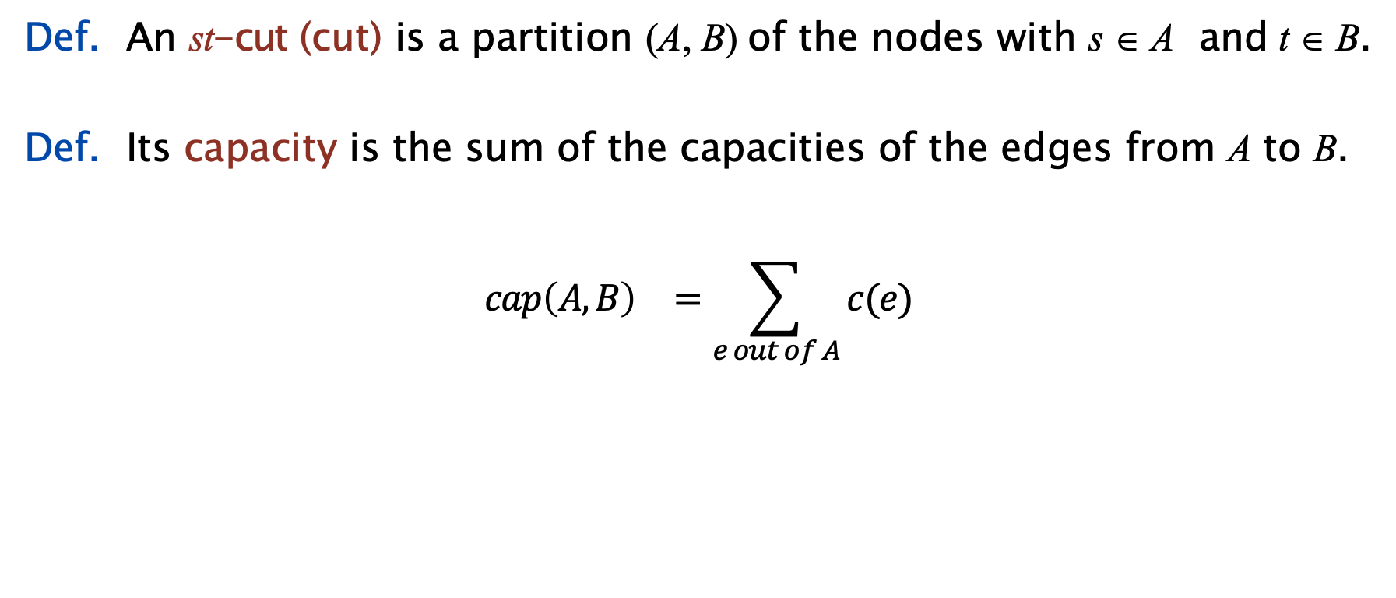
Minimum-cut problem
Def. An st-cut (cut) is a partition (A, B) of the nodes with s ∈ A and t ∈ B.
Def. Its capacity is the sum of the capacities of the edges from A to B.
$${cap\left(A,B\right)}^{}=\sum_{e out of A}{c(e)}$$
10
s
5
t
15
capacity = 10 + 5 + 15 = 30

Slide 5
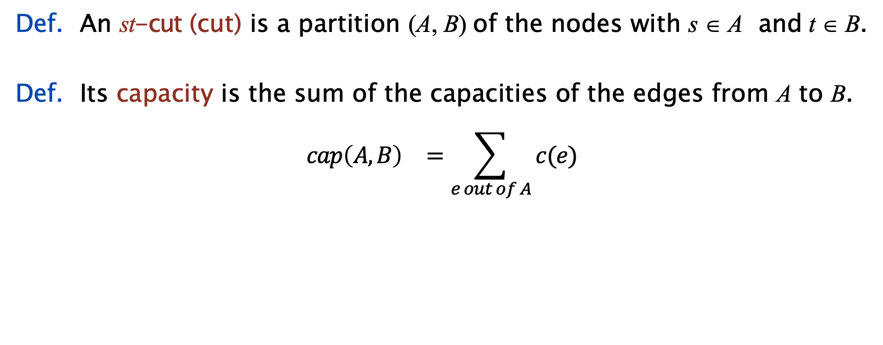
Minimum-cut problem
Def. An st-cut (cut) is a partition (A, B) of the nodes with s ∈ A and t ∈ B.
Def. Its capacity is the sum of the capacities of the edges from A to B.
$${cap\left(A,B\right)}^{}=\sum_{e out of A}{c(e)}$$
10
s
8
t
don’t include edges from B to A
capacity = 10 + 8 + 16 = 34
16
5

Slide 6
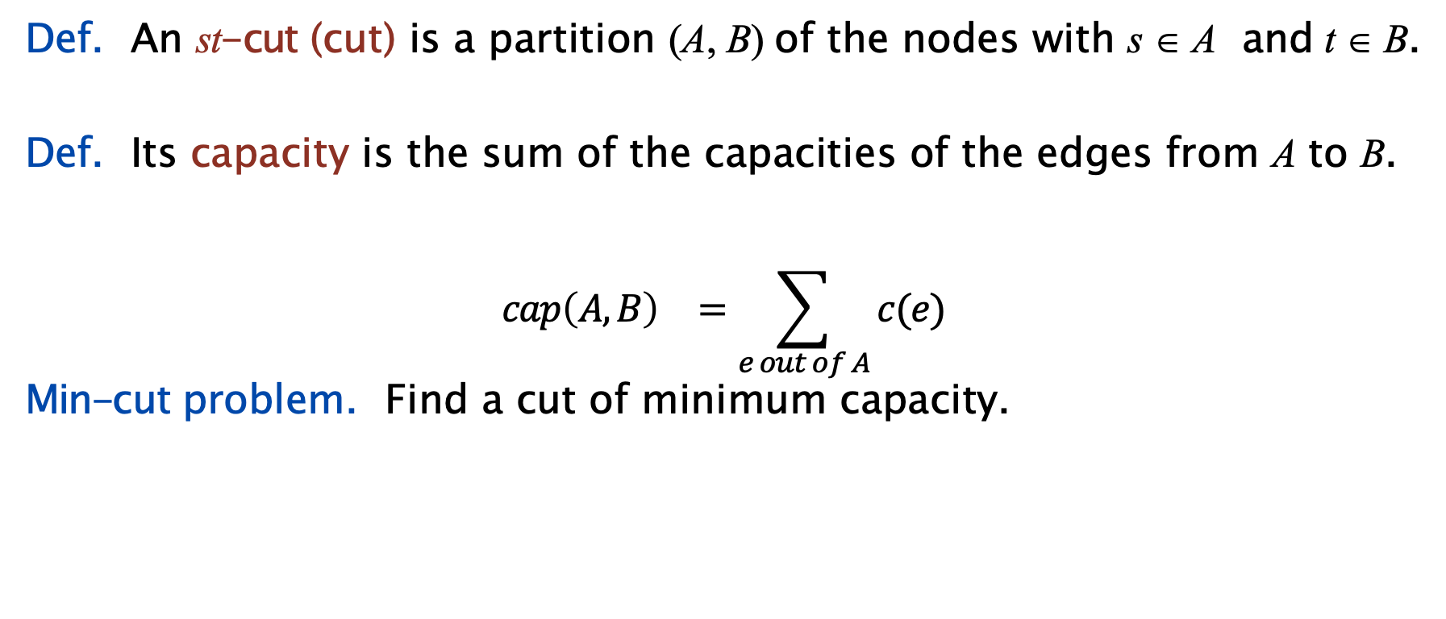
Minimum-cut problem
Def. An st-cut (cut) is a partition (A, B) of the nodes with s ∈ A and t ∈ B.
Def. Its capacity is the sum of the capacities of the edges from A to B.
$${cap\left(A,B\right)}^{}=\sum_{e out of A}{c(e)}$$
Min-cut problem. Find a cut of minimum capacity.
10
s
8
t
10
capacity = 10 + 8 + 10 = 28

Slide 7

Network flow: quiz 1
Which is the capacity of the given st-cut?
11 (20 + 25 − 8 − 11 − 9 − 6)
34 (8 + 11 + 9 + 6)
45 (20 + 25)
79 (20 + 25 + 8 + 11 + 9 + 6)
capacity
s
20
8
10
6
12
8
11
9
6
8
1
16
25
t

Slide 8
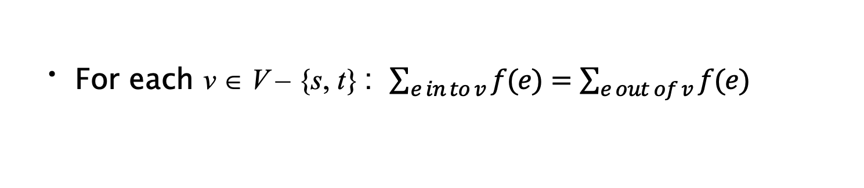
Maximum-flow problem
Def. An st-flow (flow) f is a function that satisfies:
・For each e ∈ E :
0 ≤ f (e) ≤ c(e)
[capacity]
[flow conservation]
・For each v ∈ V – {s, t} : $\sum_{e in to v}{f(e)}=\sum_{e out of v}{f(e)}$
flow
capacity
inflow at v | = | 5 + 5 + 0 | = 10
outflow at v | = | 10 + 0 | = 10
5 / 9
10 / 10
0 / 4
5 / 15
0 / 15
5 / 10
s
5 / 5
5 / 8
v
10 / 10
t
10 / 15
0 / 4
0 / 6
0 / 15
10 / 10
10 / 16

Slide 9
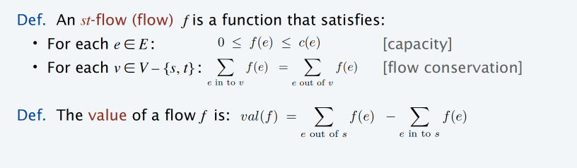
Maximum-flow problem
5 / 9
10 / 10
0 / 4
5 / 15
0 / 15
5 / 10
s
5 / 5
5 / 8
10 / 10
t
10 / 15
0 / 4
0 / 6
0 / 15
10 / 10
value = 5 + 10 + 10 = 25
10 / 16

Slide 10
Maximum-flow problem
Max-flow problem. Find a flow of maximum value.
8 / 9
10 / 10
0 / 4
2 / 15
0 / 15
8 / 10
s
5 / 5
8 / 8
10 / 10
t
13 / 15
0 / 4
3 / 6
0 / 15
10 / 10
value = 10 + 5 + 13 = 28
13 / 16
10

Slide 11
7. Network Flow I
max-flow and min-cut problems
Ford–Fulkerson algorithm
max-flow min-cut theorem
capacity-scaling algorithm
shortest augmenting paths
Dinitz’ algorithm
simple unit-capacity networks
Section 7.1

Slide 12

Toward a max-flow algorithm
Greedy algorithm.
・Start with f (e) = 0 for each edge e ∈ E.
・Find an s↝t path P where each edge has f (e) < c(e).
・Augment flow along path P.
・Repeat until you get stuck.
flow
capacity
flow network G and flow f
0 / 4
0 / 10
0 / 2
0 / 8
0 / 6
0 / 10
value of flow
s
0 / 10
0 / 9
0 / 10
t
0

Slide 13
Toward a max-flow algorithm
Greedy algorithm.
・Start with f (e) = 0 for each edge e ∈ E.
・Find an s↝t path P where each edge has f (e) < c(e).
・Augment flow along path P.
・Repeat until you get stuck.
flow network G and flow f
0 / 4
0 / 10
0 / 2
0 / 8
0 / 6
0 / 10
s
0 / 10
0 / 9
0 / 10
t
0

Slide 14
Toward a max-flow algorithm
Greedy algorithm.
・Start with f (e) = 0 for each edge e ∈ E.
・Find an s↝t path P where each edge has f (e) < c(e).
・Augment flow along path P.
・Repeat until you get stuck.
flow network G and flow f
0 / 4
8
8
—0 / 10
0 / 2
—0 / 8
0 / 6
0 / 10
8
—0 / 10
s
0 / 10
0 / 9
t
0 + 8 = 8

Slide 15
Toward a max-flow algorithm
Greedy algorithm.
・Start with f (e) = 0 for each edge e ∈ E.
・Find an s↝t path P where each edge has f (e) < c(e).
・Augment flow along path P.
・Repeat until you get stuck.
flow network G and flow f
0 / 4
10
—8 / 10
2 —0 / 2
8 / 8
0 / 6
0 / 10
2
—0 / 9
10
—8 / 10
s
0 / 10
t
8 + 2 = 10

Slide 16
Toward a max-flow algorithm
Greedy algorithm.
・Start with f (e) = 0 for each edge e ∈ E.
・Find an s↝t path P where each edge has f (e) < c(e).
・Augment flow along path P.
・Repeat until you get stuck.
flow network G and flow f
0 / 4
6
10 / 10
2 / 2
8 / 8
6 —0 / 6
—0 / 10
6
8
—2 / 9
s
—0 / 10
10 / 10
t
10 + 6 = 16

Slide 17
Toward a max-flow algorithm
Greedy algorithm.
・Start with f (e) = 0 for each edge e ∈ E.
・Find an s↝t path P where each edge has f (e) < c(e).
・Augment flow along path P.
・Repeat until you get stuck.
ending flow value = 16
flow network G and flow f
0 / 4
10 / 10
2 / 2
8 / 8
6 / 6
6 / 10
s
6 / 10
8 / 9
10 / 10
t
16

Slide 18
Toward a max-flow algorithm
Greedy algorithm.
・Start with f (e) = 0 for each edge e ∈ E.
・Find an s↝t path P where each edge has f (e) < c(e).
・Augment flow along path P.
・Repeat until you get stuck.
but max-flow value = 19
flow network G and flow f
3 / 4
10 / 10
0 / 2
7 / 8
6 / 6
9 / 10
s
9 / 10
9 / 9
10 / 10
t
19

Slide 19
Why the greedy algorithm fails
Q. Why does the greedy algorithm fail?
A. Once greedy algorithm increases flow on an edge, it never decreases it.
Ex. Consider flow network G .
・The unique max flow f * has f *(v, w) = 0.
・Greedy algorithm could choose s→v→w→t as first path.
flow network G
v
2
t
2
1
2
s
2
w
Bottom line. Need some mechanism to “undo” a bad decision.

Slide 20
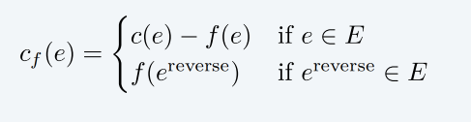
Residual network
Original edge. e = (u, v) ∈ E.
・Flow f (e).
original flow network G
・Capacity c(e).
u
6 / 17
v
flow
capacity
Reverse edge. e ^{reverse} = (v, u).
・“Undo” flow sent.
residual network Gf
residual capacity
Residual capacity.
u
11
v
6
reverse edge
edges with positive residual capacity
Residual network. G_{f} = (V, E_{f} , s, t, c_{f} ).
where flow on a reverse edge negates flow on corresponding forward edge
・E = {e : f (e) < c(e)} ∪ {e : f (e ^{reverse})
> 0}.
f
・Key property: f ʹ is a flow in G_{f} iff f + f ʹ is a flow in G.

Slide 21
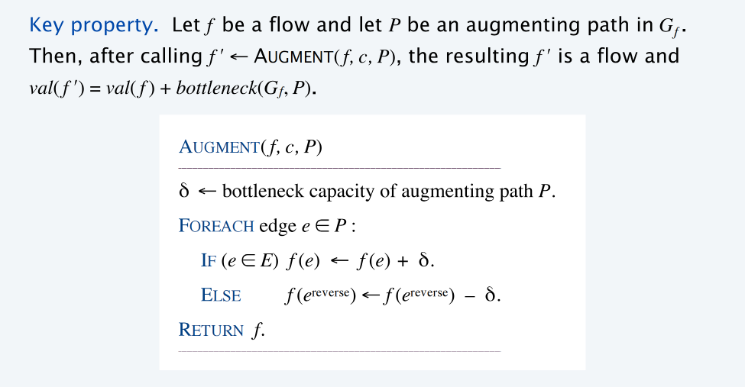
Augmenting path
Def. An augmenting path is a simple s↝t path in the residual network G_{f} .
Def. The bottleneck capacity of an augmenting path P is the minimum residual capacity of any edge in P.

Slide 22
Network flow: quiz 2
Which is the augmenting path of highest bottleneck capacity?
A → F → G → H
A → B → C → D → H
A → F → B → G → H
A → F → B → G → C → D → H
residual capacity
5
A
9
B
8
C
6
D
source
5
7
8
7
4 5
6
8 5
E
5
F
2
G
3
H
5
target
22

Slide 23

Ford–Fulkerson algorithm
Ford–Fulkerson augmenting path algorithm.
・Start with f (e) = 0 for each edge e ∈ E.
・Find an s↝t path P in the residual network G_{f} .
・Augment flow along path P.
・Repeat until you get stuck.
Ford–Fulkerson(G)
_
FOREACH edge e ∈ E : f (e) ← 0.
Gf ← residual network of G with respect to flow f. WHILE (there exists an s↝t path P in Gf )
f ← AUGMENT( f, c, P).
Update Gf.
Return f.
augmenting path
23

Slide 24
7. Network Flow I
max-flow and min-cut problems
Ford–Fulkerson algorithm
max-flow min-cut theorem
capacity-scaling algorithm
shortest augmenting paths
Dinitz' algorithm
simple unit-capacity networks
Section 7.2

Slide 25
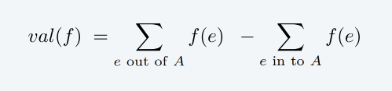
Relationship between flows and cuts
Flow value lemma. Let f be any flow and let (A, B) be any cut. Then, the value of the flow f equals the net flow across the cut (A, B).
net flow across cut = 5 + 10 + 10 = 25
5 / 9
10 / 10
0 / 4
5 / 15
0 / 15
5 / 10
s
5 / 5
5 / 8
10 / 10
t
value of flow = 25
10 / 15
0 / 4
0 / 6
0 / 15
10 / 10
10 / 16

Slide 26
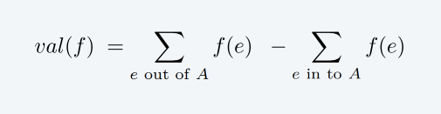
Relationship between flows and cuts
Flow value lemma. Let f be any flow and let (A, B) be any cut. Then, the value of the flow f equals the net flow across the cut (A, B).
net flow across cut = 10 + 5 + 10 = 25
5 / 9
10 / 10
0 / 4
5 / 15
0 / 15
5 / 10
s
5 / 5
5 / 8
10 / 10
t
value of flow = 25
10 / 15
0 / 4
0 / 6
0 / 15
10 / 10
10 / 16

Slide 27
Relationship between flows and cuts
Flow value lemma. Let f be any flow and let (A, B) be any cut. Then, the value of the flow f equals the net flow across the cut (A, B).
net flow across cut = (10 + 10 + 5 + 10 + 0 + 0) – (5 + 5 + 0 + 0) = 25
5 / 9
edges from B to A
10 / 10
0 / 4
5 / 15
0 / 15
5 / 10
s
5 / 5
5 / 8
10 / 10
t
value of flow = 25
10 / 15
0 / 4
0 / 6
0 / 15
10 / 10
10 / 16

Slide 28
Network flow: quiz 3
Which is the net flow across the given cut?
11 (20 + 25 − 8 − 11 − 9 − 6)
26 (20 + 22 − 8 − 4 − 4)
42 (20 + 22)
45 (20 + 25)
flow
capacity
s
20 / 20
8 / 8
4 / 10
1 / 6
5 / 12
8 / 8
4 / 11
4 / 9
0 / 6
4 / 8
1 / 1
14 / 16
22 / 25
t

Slide 29
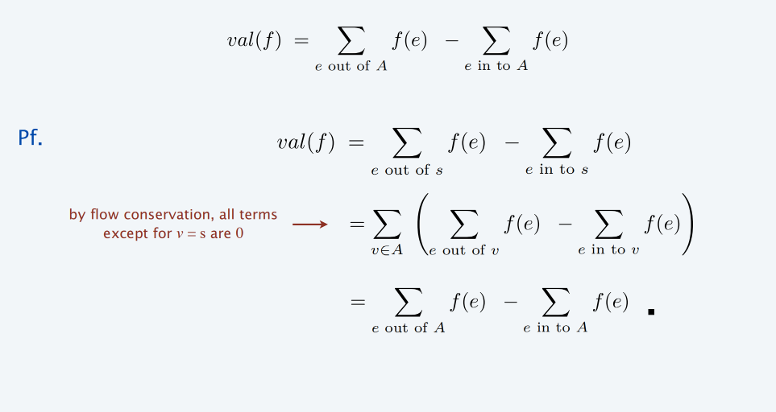
Relationship between flows and cuts
Flow value lemma. Let f be any flow and let (A, B) be any cut. Then, the value of the flow f equals the net flow across the cut (A, B).

Slide 30
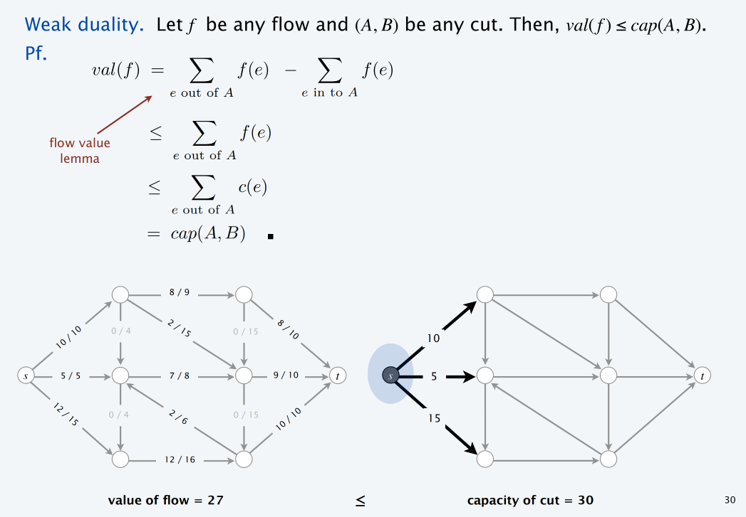
Relationship between flows and cuts
≤

Slide 31
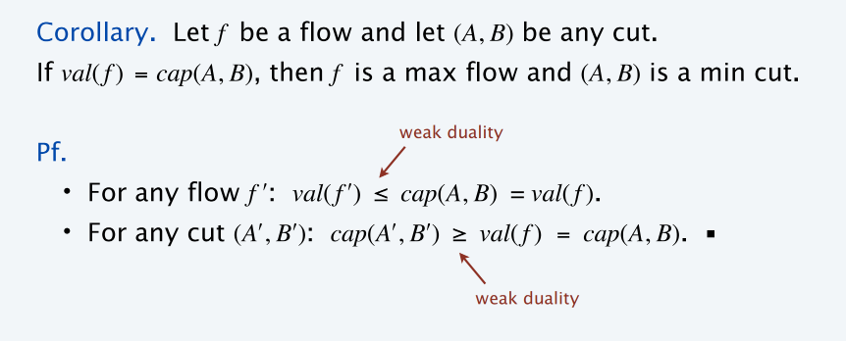
Certificate of optimality
8 / 9
10 / 10
0 / 4
2 / 15
0 / 15
8 / 10
10
s
5 / 5
8 / 8
10 / 10
t
s
8
t
13 / 15
0 / 4
3 / 6
0 / 15
10 / 10
10
13 / 16
value of flow = 28
=
capacity of cut = 28
31

Slide 32
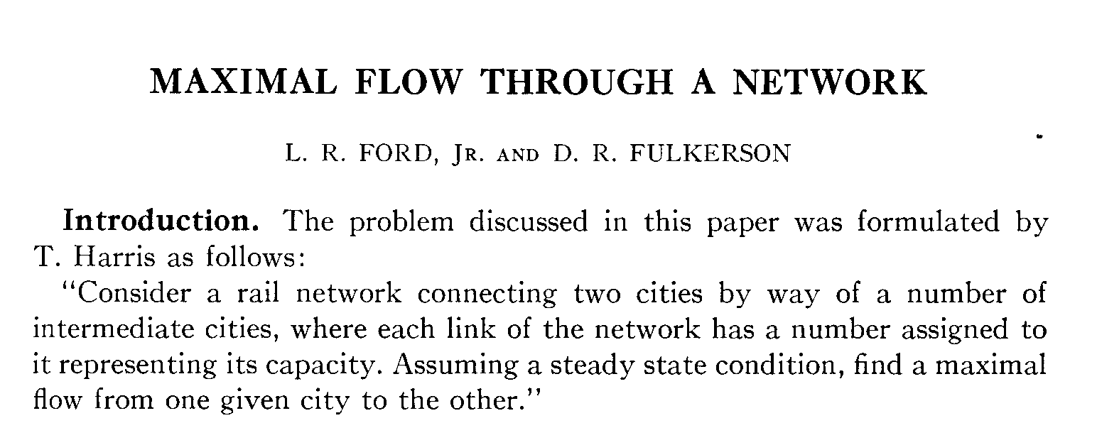
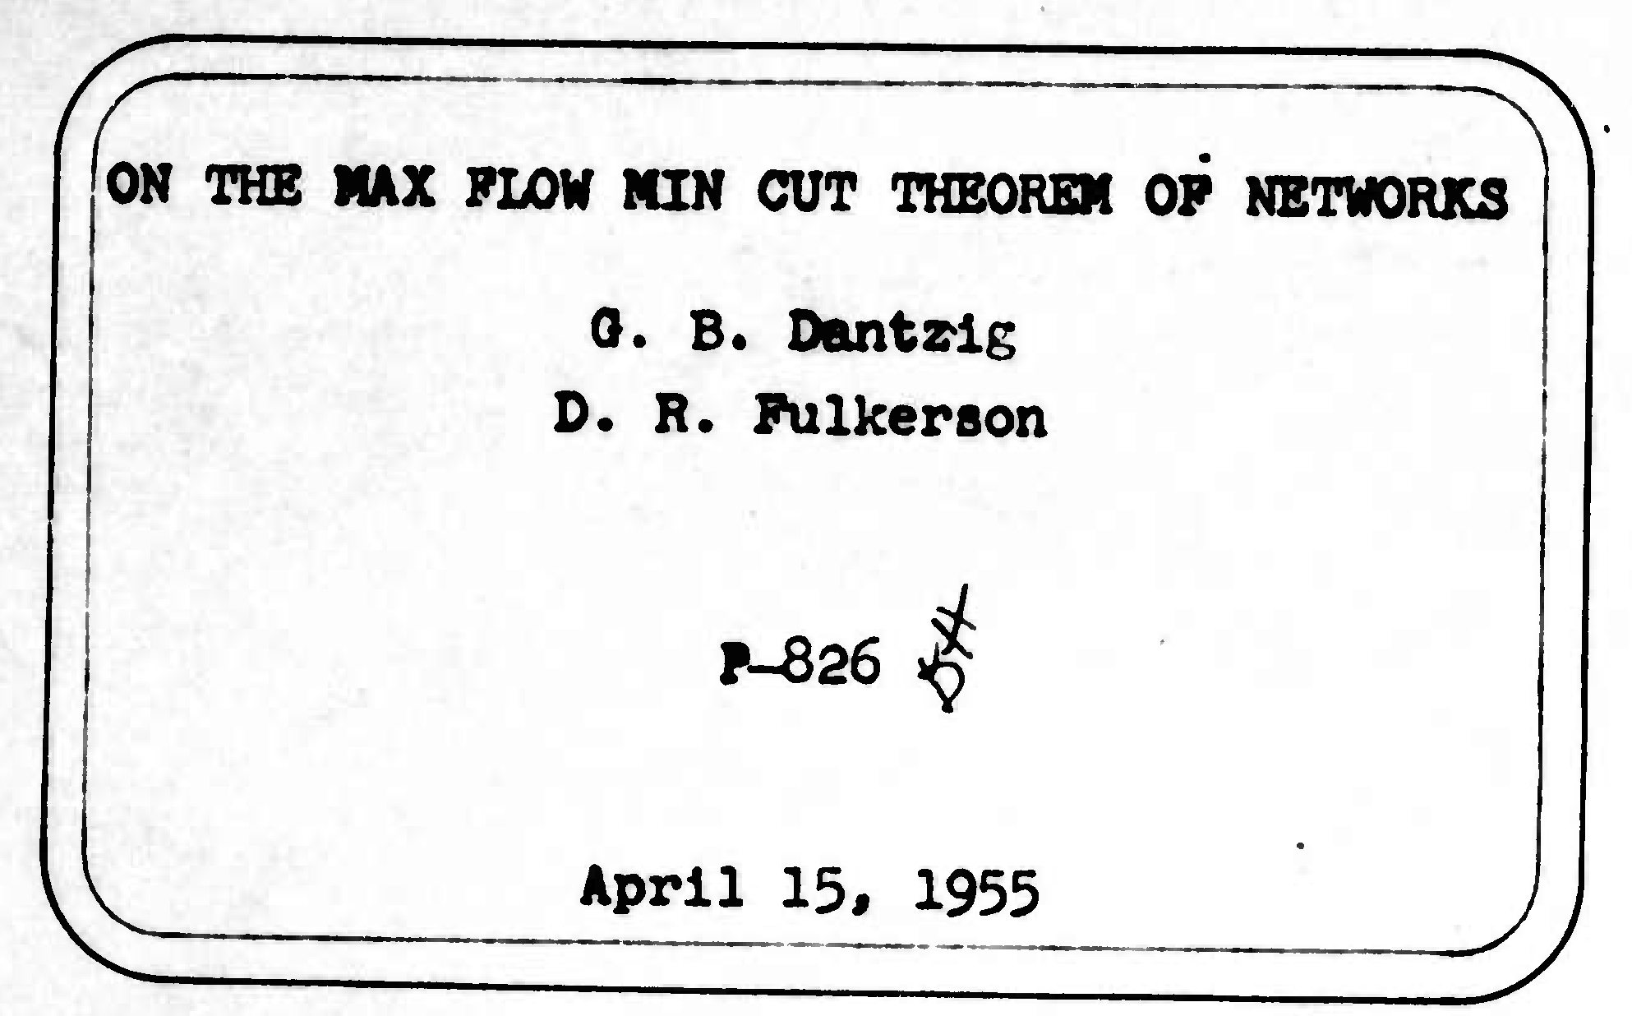
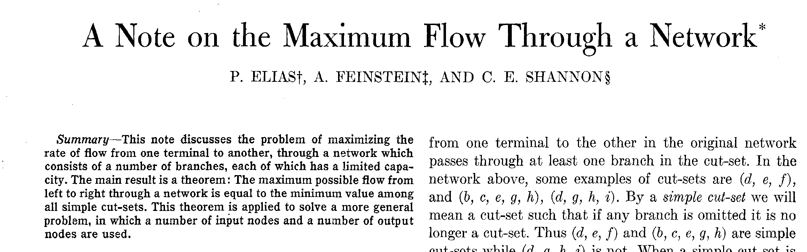
Max-flow min-cut theorem
Max-flow min-cut theorem. Value of a max flow = capacity of a min cut.
strong duality

Slide 33
Max-flow min-cut theorem
Max-flow min-cut theorem. Value of a max flow = capacity of a min cut. Augmenting path theorem. A flow f is a max flow iff no augmenting paths.
Pf. The following three conditions are equivalent for any flow f :
There exists a cut (A, B) such that cap(A, B) = val( f ).
f is a max flow.
iii. There is no augmenting path with respect to f.
if Ford–Fulkerson terminates, then f is max flow
[ i ⇒ ii ]
・This is the weak duality corollary. ▪

Slide 34
Max-flow min-cut theorem
Max-flow min-cut theorem. Value of a max flow = capacity of a min cut. Augmenting path theorem. A flow f is a max flow iff no augmenting paths.
Pf. The following three conditions are equivalent for any flow f :
There exists a cut (A, B) such that cap(A, B) = val( f ).
f is a max flow.
There is no augmenting path with respect to f.
[ ii ⇒ iii ] We prove contrapositive: ¬ iii ⇒ ¬ ii.
・Suppose that there is an augmenting path with respect to f.
・Can improve flow f by sending flow along this path.
・Thus, f is not a max flow. ▪

Slide 35
Max-flow min-cut theorem
[ iii ⇒ i ]
・Let f be a flow with no augmenting paths.
・Let A = set of nodes reachable from s in residual network Gf.
・By definition of A: s ∈ A.
・By definition of flow f: t ∉ A.
edge e = (v, w) with v ∈ B, w ∈ A
must have f (e) = 0
original flow network G
val(f ) =
f (e)
e out^{Σ}of A ^{f (e) —} e in^{Σ}to A
A
B
flow value lemma
Σ
=
c(e) — 0
t
e Qmi Q7 A
= cap(A, B)
s
edge e = (v, w) with v ∈ A, w ∈ B
must have f (e) = c(e)

Slide 36
Computing a minimum cut from a maximum flow
Theorem. Given any max flow f , can compute a min cut (A, B) in O(m) time.
Pf. Let A = set of nodes reachable from s in residual network Gf . ▪
argument from previous slide implies that capacity of (A, B) = value of flow f
8
1
8
10
4
13
15
2
2
A
ss
5
8
10
t
15
2
3 1
6
10
13
16

Slide 37

Max Flow problem
网络视频
https://www.youtube.com/watch?v=LdOnanfc5TM&t=319s
温馨提示：此视频框在点击“上传手机课件”时会进行转换，用手机进行观看时则会变为可点击的视频。此视频框可被拖动移位和修改大小。

Slide 38
7. Network Flow I
max-flow and min-cut problems
Ford–Fulkerson algorithm
max-flow min-cut theorem
capacity-scaling algorithm
shortest augmenting paths
Dinitz' algorithm
simple unit-capacity networks
Section 7.3

Slide 39
Analysis of Ford–Fulkerson algorithm (when capacities are integral)
Assumption. Every edge capacity c(e) is an integer between 1 and C.
Integrality invariant. Throughout Ford–Fulkerson, every edge flow f (e)
and residual capacity c_{f} (e) is an integer.
Pf. By induction on the number of augmenting paths. ▪
consider cut A = { s }
(assumes no parallel edges)
Theorem. Ford–Fulkerson terminates after at most val( f *) ≤ n C
augmenting paths, where f * is a max flow.
Pf. Each augmentation increases the value of the flow by at least 1. ▪
Corollary. The running time of Ford–Fulkerson is O(m n C).
Pf. Can use either BFS or DFS to find an augmenting path in O(m) time. ▪
f (e) is an integer for every e
Integrality theorem. There exists an integral max flow f *.
Pf. Since Ford–Fulkerson terminates, theorem follows from integrality invariant (and augmenting path theorem). ▪

Slide 40
Ford–Fulkerson: exponential example
Q. Is generic Ford–Fulkerson algorithm poly-time in input size?
m, n, and log C
A. No. If max capacity is C, then algorithm can take ≥ C iterations.
・s→v→w→t
・s→w→v→t
・s→v→w→t
・s→w→v→t
・…
・s→v→w→t
・s→w→v→t
each augmenting path sends only 1 unit of flow (# augmenting paths = 2C)
s
C
C
v
1
w
C
C
t

Slide 41
Network flow: quiz 4
The Ford–Fulkerson algorithm is guaranteed to terminate if the edge capacities are …
Rational numbers.
Real numbers.
Both A and B.
Neither A nor B.
Let D denote the product (or lcm) of the denominators.
Then, every edge flow f (e) and every residual capacity c_{f} (e)
is a multiple of 1 / D.

Slide 42
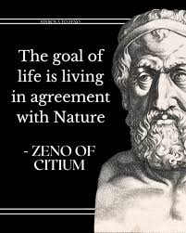
Choosing good augmenting paths
Use care when selecting augmenting paths.
・Some choices lead to exponential algorithms.
・Clever choices lead to polynomial algorithms.
Pathology. When edge capacities can be irrational, no guarantee that Ford–Fulkerson terminates (or converges to a maximum flow)!
Goal. Choose augmenting paths so that:
・Can find augmenting paths efficiently.
・Few iterations.

Slide 43
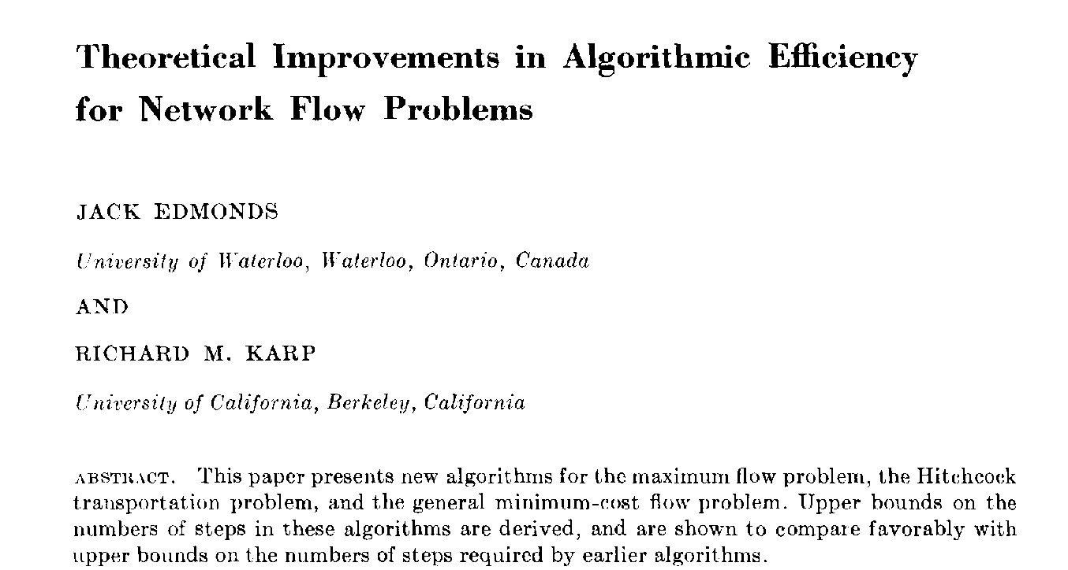
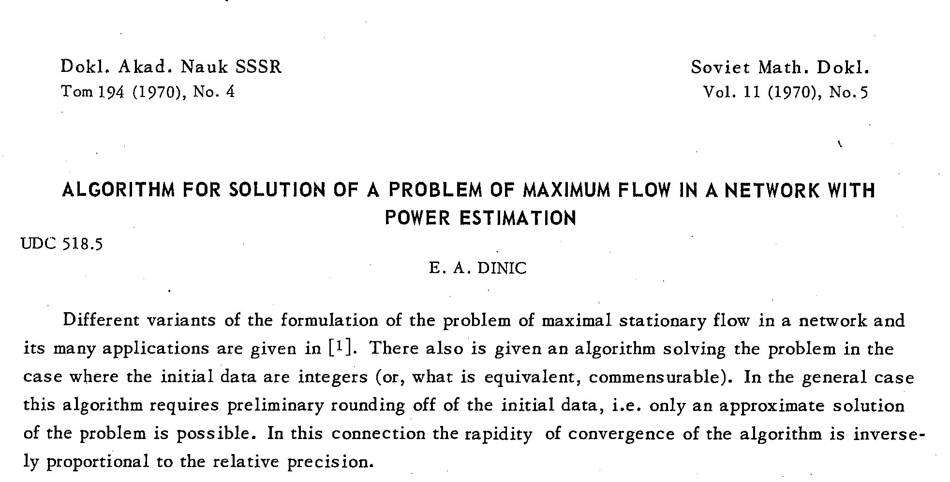
Choosing good augmenting paths
Choose augmenting paths with:
・Max bottleneck capacity (“fattest”).
・Sufficiently large bottleneck capacity.
how to find?
next
・Fewest edges.
ahead
Edmonds-Karp 1972 (USA)
Dinitz 1970 (Soviet Union)
invented in response to a class exercises by Adel’son-Vel’skiĭ

Slide 44
Capacity-scaling algorithm
Overview. Choosing augmenting paths with “large” bottleneck capacity.
・Maintain scaling parameter Δ.
・Let G_{f} (Δ) be the part of the residual network containing only those edges with capacity ≥ Δ.
・Any augmenting path in G_{f} (Δ) has bottleneck capacity ≥ Δ.
though not necessarily largest
s
s
110
102
110
102
1
122
170
122
170
t
t
Gf
Gf (Δ), Δ = 100
43

Slide 45
Capacity-scaling algorithm
Capacity-Scaling(G)
FOREACH edge e ∈ E : f (e) ← 0.
Δ ← largest power of 2 ≤ C.
WHILE (Δ ≥ 1)
Gf (Δ) ← Δ-residual network of G with respect to flow f . WHILE (there exists an s↝t path P in Gf (Δ))
f ← AUGMENT( f, c, P).
Update Gf (Δ).
Δ ← Δ / 2.
Δ-scaling phase
Return f.

Slide 46
Capacity-scaling algorithm: proof of correctness
Assumption. All edge capacities are integers between 1 and C.
Invariant. The scaling parameter Δ is a power of 2.
Pf. Initially a power of 2; each phase divides Δ by exactly 2. ▪
Integrality invariant. Throughout the algorithm, every edge flow f (e) and residual capacity c_{f} (e) is an integer.
Pf. Same as for generic Ford–Fulkerson. ▪
Theorem. If capacity-scaling algorithm terminates, then f is a max flow. Pf.
・By integrality invariant, when Δ = 1 ⇒ G_{f} (Δ) = G_{f} .
・Upon termination of Δ = 1 phase, there are no augmenting paths.
・Result follows augmenting path theorem ▪

Slide 47
Capacity-scaling algorithm: analysis of running time
Lemma 1. There are 1 + ⎣log₂ C⎦ scaling phases.
Pf. Initially C / 2 < Δ ≤ C; Δ decreases by a factor of 2 in each iteration. ▪
Lemma 2. Let f be the flow at the end of a Δ-scaling phase. Then, the max-flow value ≤ val( f ) + m Δ.
Pf. Next slide.
Lemma 3. There are ≤ 2m augmentations per scaling phase. Pf.
・Let f be the flow at the beginning of a Δ-scaling phase.
or equivalently, at the end
of a 2Δ-scaling phase
・Lemma 2 ⇒ max-flow value ≤ val( f ) + m (2 Δ).
・Each augmentation in a Δ-phase increases val( f ) by at least Δ. ▪
Theorem. The capacity-scaling algorithm takes O(m² log C) time. Pf.
・Lemma 1 + Lemma 3
⇒ O(m log C) augmentations.
・Finding an augmenting path takes O(m) time. ▪
46

Slide 48
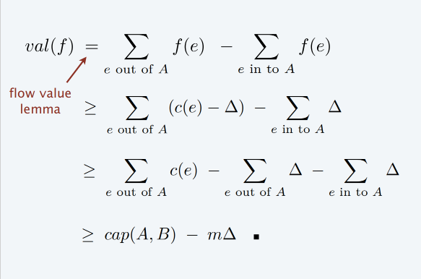
Capacity-scaling algorithm: analysis of running time
Lemma 2. Let f be the flow at the end of a Δ-scaling phase. Then, the max-flow value ≤ val( f ) + m Δ.
Pf.
・We show there exists a cut (A, B) such that cap(A, B) ≤ val( f ) + m Δ.
・Choose A to be the set of nodes reachable from s in G_{f} (Δ).
・By definition of A: s ∈ A.
・By definition of flow f: t ∉ A.
edge e = (v, w) with v ∈ B, w ∈ A
must have f (e) < Δ
original flow network
A
B
t
s
edge e = (v, w) with v ∈ A, w ∈ B
must have f (e) > c(e) – Δ
47

Slide 49
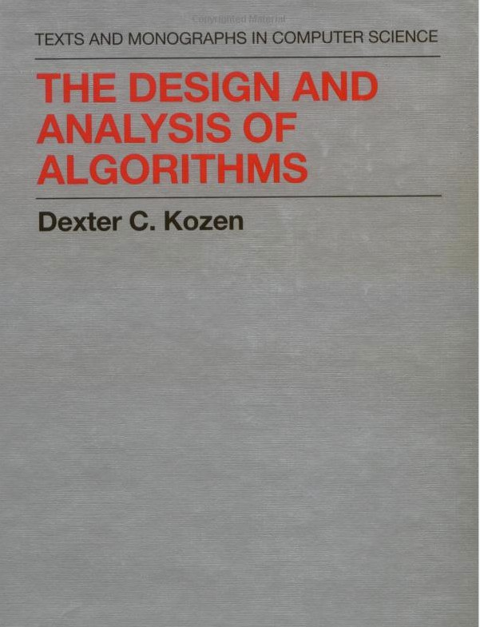
7. Network Flow I
max-flow and min-cut problems
Ford–Fulkerson algorithm
max-flow min-cut theorem
capacity-scaling algorithm
shortest augmenting paths
Dinitz’ algorithm
simple unit-capacity networks
Section 17.2

Slide 50
Shortest augmenting path
Q. How to choose next augmenting path in Ford–Fulkerson?
A. Pick one that uses the fewest edges.
can find via BFS
Shortest-Augmenting-Path(G) Foreach e ∈ E : f (e) ← 0.
Gf ← residual network of G with respect to flow f. WHILE (there exists an s↝t path in Gf )
P ← BREADTH-FIRST-SEARCH(Gf ).
f ← AUGMENT( f, c, P).
Update Gf.
Return f.

Slide 51
Shortest augmenting path: overview of analysis
Lemma 1. The length of a shortest augmenting path never decreases. Pf. Ahead.
number of edges
Lemma 2. After at most m shortest-path augmentations, the length of a shortest augmenting path strictly increases.
Pf. Ahead.
Theorem. The shortest-augmenting-path algorithm takes O(m² n) time. Pf.
・O(m) time to find a shortest augmenting path via BFS.
・There are ≤ m n augmentations.
-
-
at most m augmenting paths of length k
at most n−1 different lengths ▪
Lemma 1 + Lemma 2
augmenting paths are simple paths

Slide 52

Shortest augmenting path: analysis
Def. Given a digraph G = (V, E) with source s, its level graph is defined by:
・ℓ(v) = number of edges in shortest s↝v path.
・L_{G} = (V, E_{G}) is the subgraph of G that contains only those edges (v, w) ∈ E
with ℓ(w) = ℓ(v) + 1.
graph G
s
t
level graph LG
s
t
ℓ = 0
ℓ = 1
ℓ = 2
ℓ = 3

Slide 53
Network flow: quiz 5
Which edges are in the level graph of the following digraph?
D→F.
E→F.
Both A and B.
Neither A nor B.
1 3
B
D
source A
C
E
F sink
0 1 2 3

Slide 54
Shortest augmenting path: analysis
Def. Given a digraph G = (V, E) with source s, its level graph is defined by:
・ℓ(v) = number of edges in shortest s↝v path.
・L_{G} = (V, E_{G}) is the subgraph of G that contains only those edges (v, w) ∈ E
with ℓ(w) = ℓ(v) + 1.
Key property.
P is a shortest s↝v path in G iff P is an s↝v path in L_{G}.
level graph LG
s
t
ℓ = 0
ℓ = 1
ℓ = 2
ℓ = 3

Slide 55
Shortest augmenting path: analysis
Lemma 1. The length of a shortest augmenting path never decreases.
・Let f and f ʹ be flow before and after a shortest-path augmentation.
・Let L_{G} and L_{G ʹ} be level graphs of G_{f} and G_{f ʹ} .
・Only back edges added to G_{f ′}
(any s↝t path that uses a back edge is longer than previous length) ▪
level graph LG
s
t
ℓ = 0
ℓ = 1
ℓ = 2
ℓ = 3
level graph LG′
s
t

Slide 56
Shortest augmenting path: analysis
Lemma 2. After at most m shortest-path augmentations, the length of a shortest augmenting path strictly increases.
・At least one (bottleneck) edge is deleted from L_{G} per augmentation.
・No new edge added to L_{G} until shortest path length strictly increases. ▪
level graph LG
s
t
ℓ = 0
ℓ = 1
ℓ = 2
ℓ = 3
level graph LG′
s
t

Slide 57
Shortest augmenting path: review of analysis
Lemma 1. Throughout the algorithm, the length of a shortest augmenting path never decreases.
Lemma 2. After at most m shortest-path augmentations, the length of a shortest augmenting path strictly increases.
Theorem. The shortest-augmenting-path algorithm takes O(m² n) time.

Slide 58
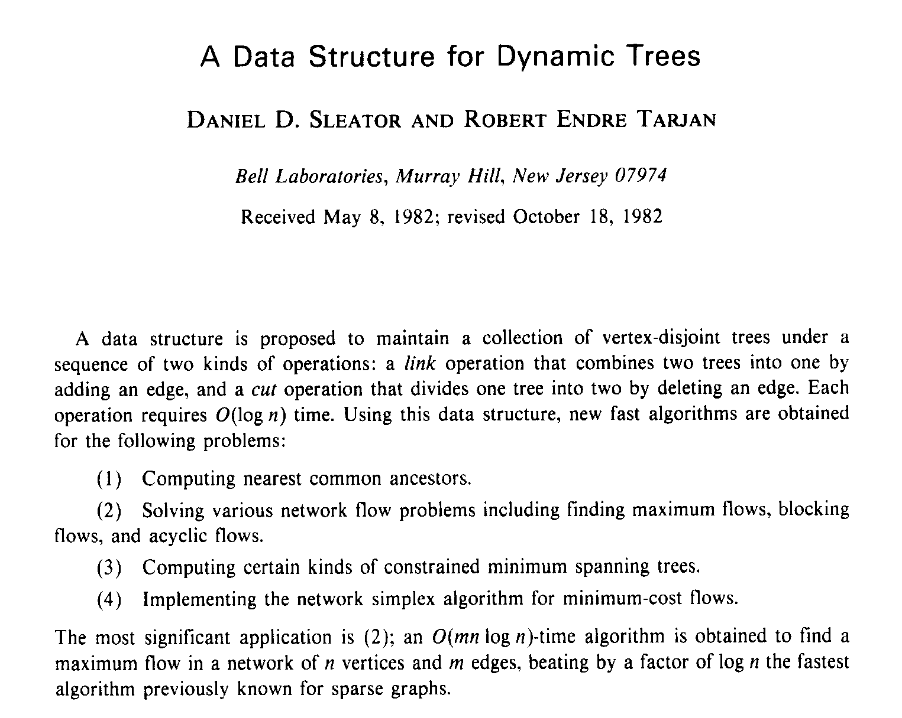
Shortest augmenting path: improving the running time
Note. Θ(m n) augmentations necessary for some flow networks.
・Try to decrease time per augmentation instead.
・Simple idea
・Dynamic trees
⇒ O(mn² ) [Dinitz 1970]
⇒ O(m n log n)
ahead
[Sleator–Tarjan 1983]

Slide 59
7. Network Flow I
max-flow and min-cut problems
Ford–Fulkerson algorithm
max-flow min-cut theorem
capacity-scaling algorithm
shortest augmenting paths
Dinitz’ algorithm
simple unit-capacity networks
Section 18.1

Slide 60
Dinitz’ algorithm
Two types of augmentations.
・Normal: length of shortest path does not change.
・Special: length of shortest path strictly increases.
Phase of normal augmentations.
within a phase, length of shortest augmenting path does not change
・Construct level graph L_{G}.
・Start at s, advance along an edge in LG until reach t or get stuck.
・If reach t, augment flow; update L_{G}; and restart from s.
・If get stuck, delete node from L_{G} and retreat to previous node.
construct level graph
s
t
level graph LG

Slide 61
Dinitz’ algorithm
Two types of augmentations.
・Normal: length of shortest path does not change.
・Special: length of shortest path strictly increases.
Phase of normal augmentations.
・Construct level graph L_{G}.
・Start at s, advance along an edge in LG until reach t or get stuck.
・If reach t, augment flow; update L_{G}; and restart from s.
・If get stuck, delete node from L_{G} and retreat to previous node.
advance
s
t
level graph LG

Slide 62
Dinitz’ algorithm
Two types of augmentations.
・Normal: length of shortest path does not change.
・Special: length of shortest path strictly increases.
Phase of normal augmentations.
・Construct level graph L_{G}.
・Start at s, advance along an edge in LG until reach t or get stuck.
・If reach t, augment flow; update L_{G}; and restart from s.
・If get stuck, delete node from L_{G} and retreat to previous node.
augment
remove from level graph edges with bottleneck capacity
s
t
level graph LG

Slide 63
Dinitz’ algorithm
Two types of augmentations.
・Normal: length of shortest path does not change.
・Special: length of shortest path strictly increases.
Phase of normal augmentations.
・Construct level graph L_{G}.
・Start at s, advance along an edge in LG until reach t or get stuck.
・If reach t, augment flow; update L_{G}; and restart from s.
・If get stuck, delete node from L_{G} and retreat to previous node.
advance
s
t
level graph LG

Slide 64
Dinitz’ algorithm
Two types of augmentations.
・Normal: length of shortest path does not change.
・Special: length of shortest path strictly increases.
Phase of normal augmentations.
・Construct level graph L_{G}.
・Start at s, advance along an edge in LG until reach t or get stuck.
・If reach t, augment flow; update L_{G}; and restart from s.
・If get stuck, delete node from L_{G} and retreat to previous node.
retreat
s
t
level graph LG

Slide 65
Dinitz’ algorithm
Two types of augmentations.
・Normal: length of shortest path does not change.
・Special: length of shortest path strictly increases.
Phase of normal augmentations.
・Construct level graph L_{G}.
・Start at s, advance along an edge in LG until reach t or get stuck.
・If reach t, augment flow; update L_{G}; and restart from s.
・If get stuck, delete node from L_{G} and retreat to previous node.
advance
s
t
level graph LG

Slide 66
Dinitz’ algorithm
Two types of augmentations.
・Normal: length of shortest path does not change.
・Special: length of shortest path strictly increases.
Phase of normal augmentations.
・Construct level graph L_{G}.
・Start at s, advance along an edge in LG until reach t or get stuck.
・If reach t, augment flow; update L_{G}; and restart from s.
・If get stuck, delete node from L_{G} and retreat to previous node.
augment
s
t
level graph LG

Slide 67
Dinitz’ algorithm
Two types of augmentations.
・Normal: length of shortest path does not change.
・Special: length of shortest path strictly increases.
Phase of normal augmentations.
・Construct level graph L_{G}.
・Start at s, advance along an edge in LG until reach t or get stuck.
・If reach t, augment flow; update L_{G}; and restart from s.
・If get stuck, delete node from L_{G} and retreat to previous node.
advance
s
t
level graph LG

Slide 68
Dinitz’ algorithm
Two types of augmentations.
・Normal: length of shortest path does not change.
・Special: length of shortest path strictly increases.
Phase of normal augmentations.
・Construct level graph L_{G}.
・Start at s, advance along an edge in LG until reach t or get stuck.
・If reach t, augment flow; update L_{G}; and restart from s.
・If get stuck, delete node from L_{G} and retreat to previous node.
retreat
s
t
level graph LG

Slide 69
Dinitz’ algorithm
Two types of augmentations.
・Normal: length of shortest path does not change.
・Special: length of shortest path strictly increases.
Phase of normal augmentations.
・Construct level graph L_{G}.
・Start at s, advance along an edge in LG until reach t or get stuck.
・If reach t, augment flow; update L_{G}; and restart from s.
・If get stuck, delete node from L_{G} and retreat to previous node.
retreat
s
t
level graph LG

Slide 70
Dinitz’ algorithm
Two types of augmentations.
・Normal: length of shortest path does not change.
・Special: length of shortest path strictly increases.
Phase of normal augmentations.
・Construct level graph L_{G}.
・Start at s, advance along an edge in LG until reach t or get stuck.
・If reach t, augment flow; update L_{G}; and restart from s.
・If get stuck, delete node from L_{G} and retreat to previous node.
end of phase
s
t
level graph LG

Slide 71
Dinitz’ algorithm (as refined by Even and Itai)
Initialize(G, f )
LG ← level-graph of Gf.
P ← ∅.
Goto Advance(s).
ADVANCE(v) IF (v = t)
Augment(P).
Remove saturated edges from LG. P ← ∅.
Goto Advance(s).
IF (there exists edge (v, w) ∈ LG) Add edge (v, w) to P.
Goto Advance(w).
Else
Goto Retreat(v).
RETREAT(v) IF (v = s)
Stop.
Else
Delete v (and all incident edges) from LG. Remove last edge (u, v) from P.
Goto Advance(u).

Slide 72
Network flow: quiz 6
How to compute the level graph LG efficiently?
Depth-first search.
Breadth-first search.
Both A and B.
Neither A nor B.
1 3
B
D
source A
C
E
F sink
0 1 2 3

Slide 73
Dinitz’ algorithm: analysis
Lemma. A phase can be implemented to run in O(m n) time. Pf.
・Initialization happens once per phase.
・At most m augmentations per phase.
O(m) using BFS
O(mn) per phase
(because an augmentation deletes at least one edge from L_{G})
・At most n retreats per phase.
O(m + n) per phase
(because a retreat deletes one node from L_{G})
・At most mn advances per phase.
O(mn) per phase
(because at most n advances before retreat or augmentation) ▪
Theorem. [Dinitz 1970] Dinitz’ algorithm runs in O(mn²) time. Pf.
・By Lemma, O(mn) time per phase.
・At most n−1 phases (as in shortest-augmenting-path analysis). ▪

Slide 74
网络视频
https://www.youtube.com/watch?v=M6cm8UeeziI
温馨提示：此视频框在点击“上传手机课件”时会进行转换，用手机进行观看时则会变为可点击的视频。此视频框可被拖动移位和修改大小。

Slide 75
Augmenting-path algorithms: summary
year | method | # augmentations | running time
1955 | augmenting path | n C | O(m n C)
1972 | fattest path | m log (mC) | O(m² log n log (mC))
1972 | capacity scaling | m log C | O(m² log C)
1985 | improved capacity scaling | m log C | O(m n log C)
1970 | shortest augmenting path | m n | O(m² n)
1970 | level graph | m n | O(m n² )
1983 | dynamic trees | m n | O(m n log n )
fat paths
shortest paths
augmenting-path algorithms with m edges, n nodes, and integer capacities between 1 and C

Slide 76

Maximum-flow algorithms: theory highlights
year | method | worst case | discovered by
1951 | simplex | O(m n² C) | Dantzig
1955 | augmenting paths | O(m n C) | Ford–Fulkerson
1970 | shortest augmenting paths | O(m n²) | Edmonds–Karp, Dinitz
1974 | blocking flows | O(n³) | Karzanov
1983 | dynamic trees | O(m n log n) | Sleator–Tarjan
1985 | improved capacity scaling | O(m n log C) | Gabow
1988 | push–relabel | O(m n log (n² / m)) | Goldberg–Tarjan
1998 | binary blocking flows | O(m^{3/2} log (n² / m) log C) | Goldberg–Rao
2013 | compact networks | O(m n) | Orlin
2014 | interior-point methods | Õ(m n^{1/2} log C) | Lee–Sidford
2016 | electrical flows | _{Õ(m}10/7 _{C}1/7₎ | Mądry
20xx
max-flow algorithms with m edges, n nodes, and integer capacities between 1 and C
74

Slide 77


Slide 78
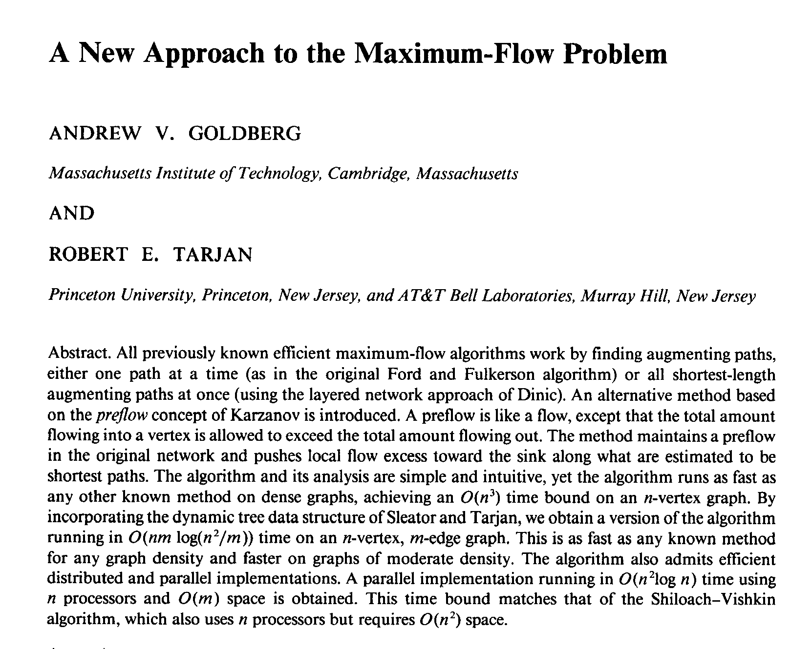
Maximum-flow algorithms: practice
Push–relabel algorithm (SECTION 7.4). [Goldberg–Tarjan 1988]
Increases flow one edge at a time instead of one augmenting path at a time.

Slide 79
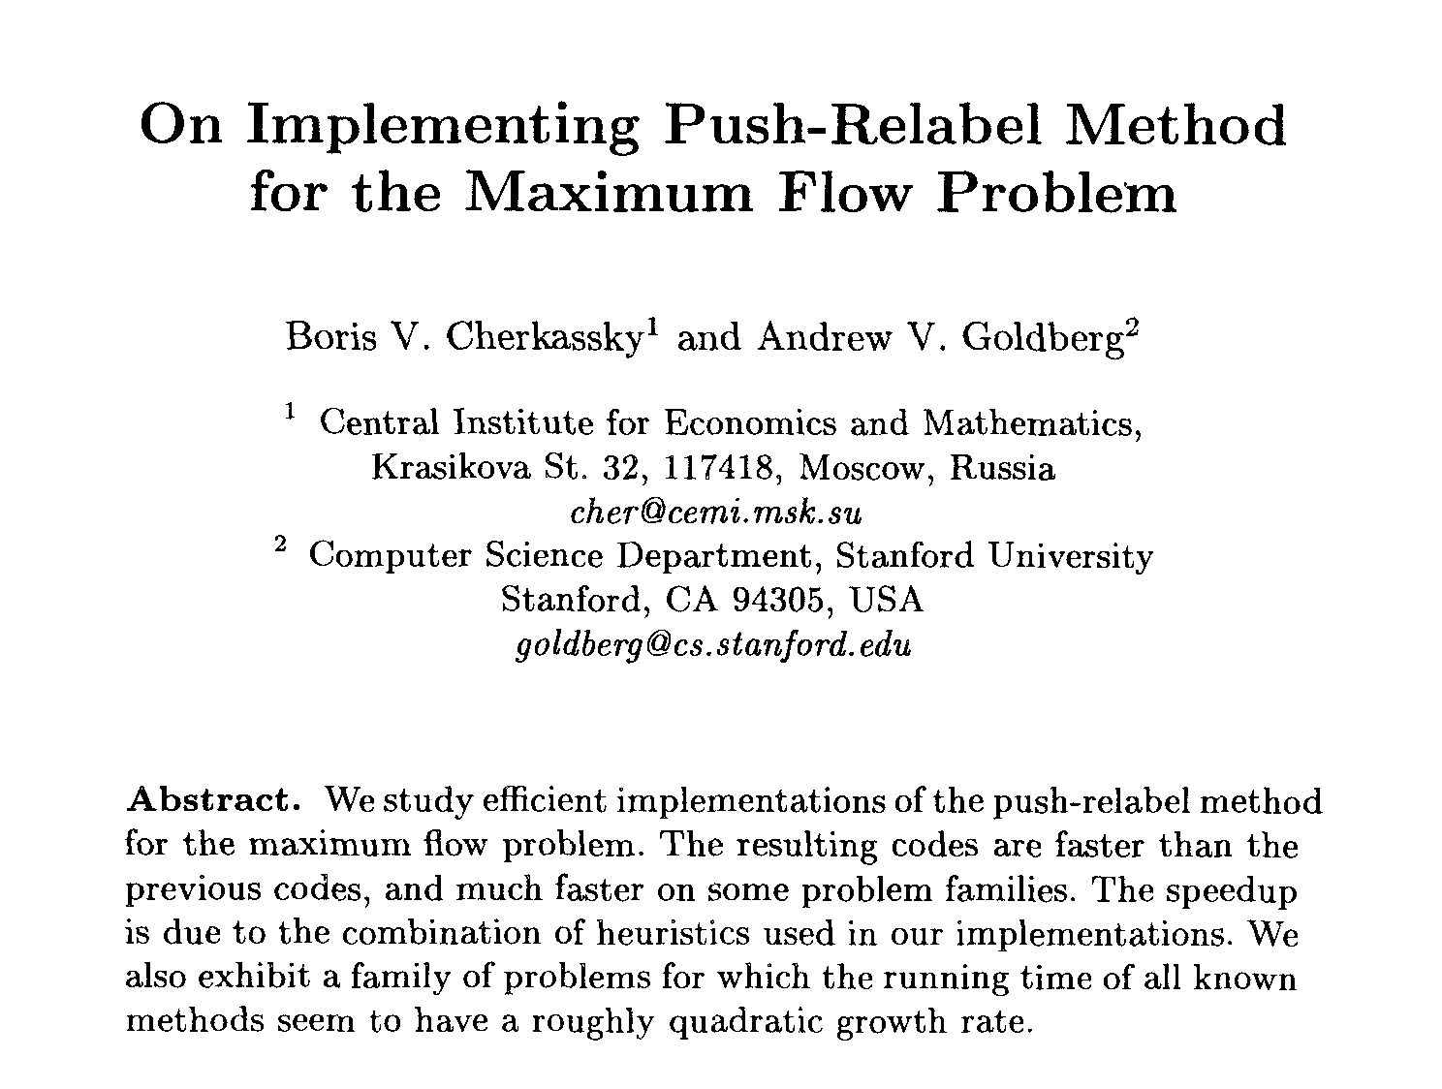
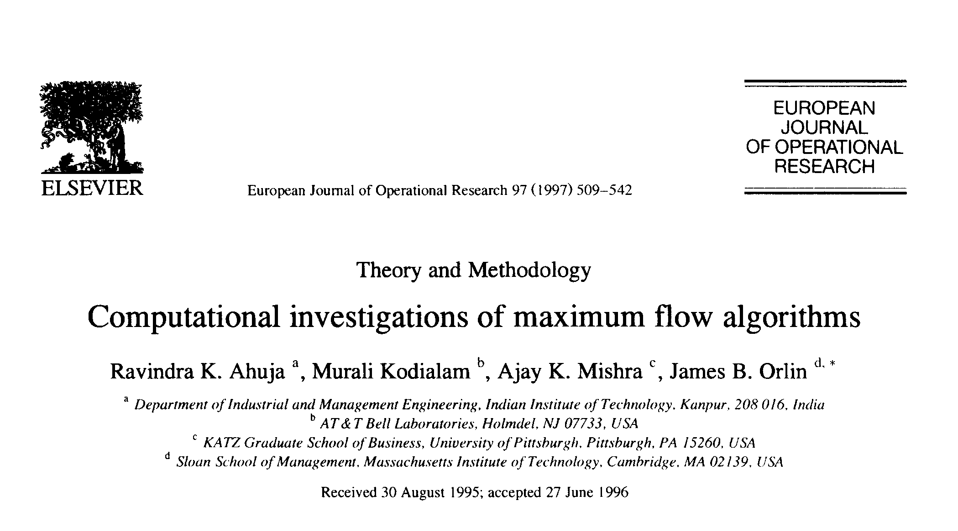
Maximum-flow algorithms: practice
Caveat. Worst-case running time is generally not useful for predicting or comparing max-flow algorithm performance in practice.
Best in practice. Push–relabel method with gap relabeling: O(m^{3/2}) in practice.

Slide 80
Maximum-flow algorithms: practice
Computer vision. Different algorithms work better for some dense problems that arise in applications to computer vision.
An Experimental Comparison of Min-Cut/Max-Flow Algorithms for Energy Minimization in Vision
Yuri Boykov and Vladimir Kolmogorov∗
Abstract
After [15, 31, 19, 8, 25, 5] minimum cut/maximum flow algorithms on graphs emerged as an increasingly useful tool for exact or approximate energy minimization in low-level vision. The combinatorial optimization literature provides many min-cut/max-flow algorithms with different polynomial time complexity. Their practical efficiency, however, has to date been studied mainly outside the scope of computer vision. The goal of this paper is to provide an experimental comparison of the efficiency of min-cut/max flow algorithms for applications in vision. We compare the running times of several standard algorithms, as well as a new algorithm that we have recently developed. The algorithms we study include both Goldberg-Tarjan style “push-relabel” methods and algorithms based on Ford-Fulkerson style “augmenting paths”. We benchmark these algorithms on a number of typical graphs in the contexts of image restoration, stereo, and segmentation. In many cases our new algorithm works several times faster than any of the other methods making near real-time performance possible. An implementation of our max-flow/min-cut algorithm is available upon request for research purposes.
VERMA, BATRA: MAXFLOW REVISITED
1
MaxFlow Revisited:
An Empirical Comparison of Maxflow Algorithms for Dense Vision Problems
Tanmay Verma tanmay08054@iiitd.ac.in Dhruv Batra
dbatra@ttic.edu
IIIT-Delhi Delhi, India
TTI-Chicago Chicago, USA
Abstract
Algorithms for finding the maximum amount of flow possible in a network (or max- flow) play a central role in computer vision problems. We present an empirical compari- son of different max-flow algorithms on modern problems. Our problem instances arise from energy minimization problems in Object Category Segmentation, Image Deconvo- lution, Super Resolution, Texture Restoration, Character Completion and 3D Segmen- tation. We compare 14 different implementations and find that the most popularly used implementation of Kolmogorov [5] is no longer the fastest algorithm available, especially for dense graphs.

Slide 81
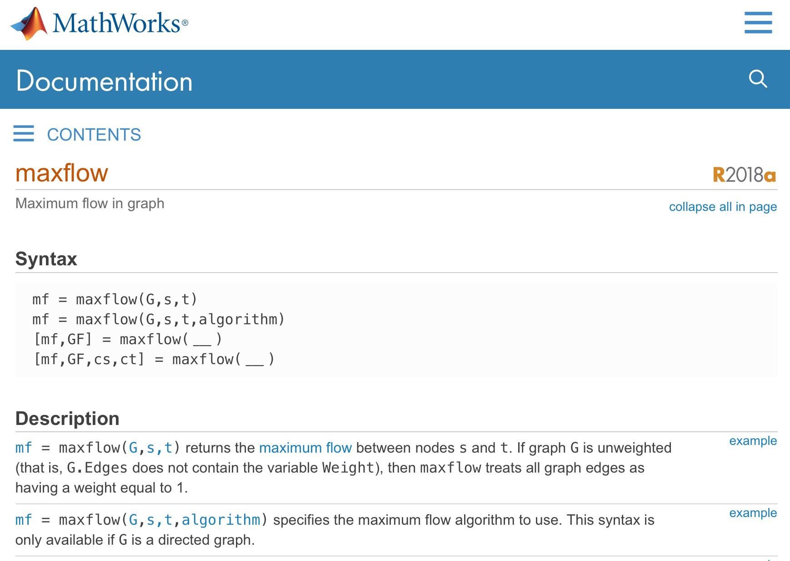
Maximum-flow algorithms: Matlab

Slide 82
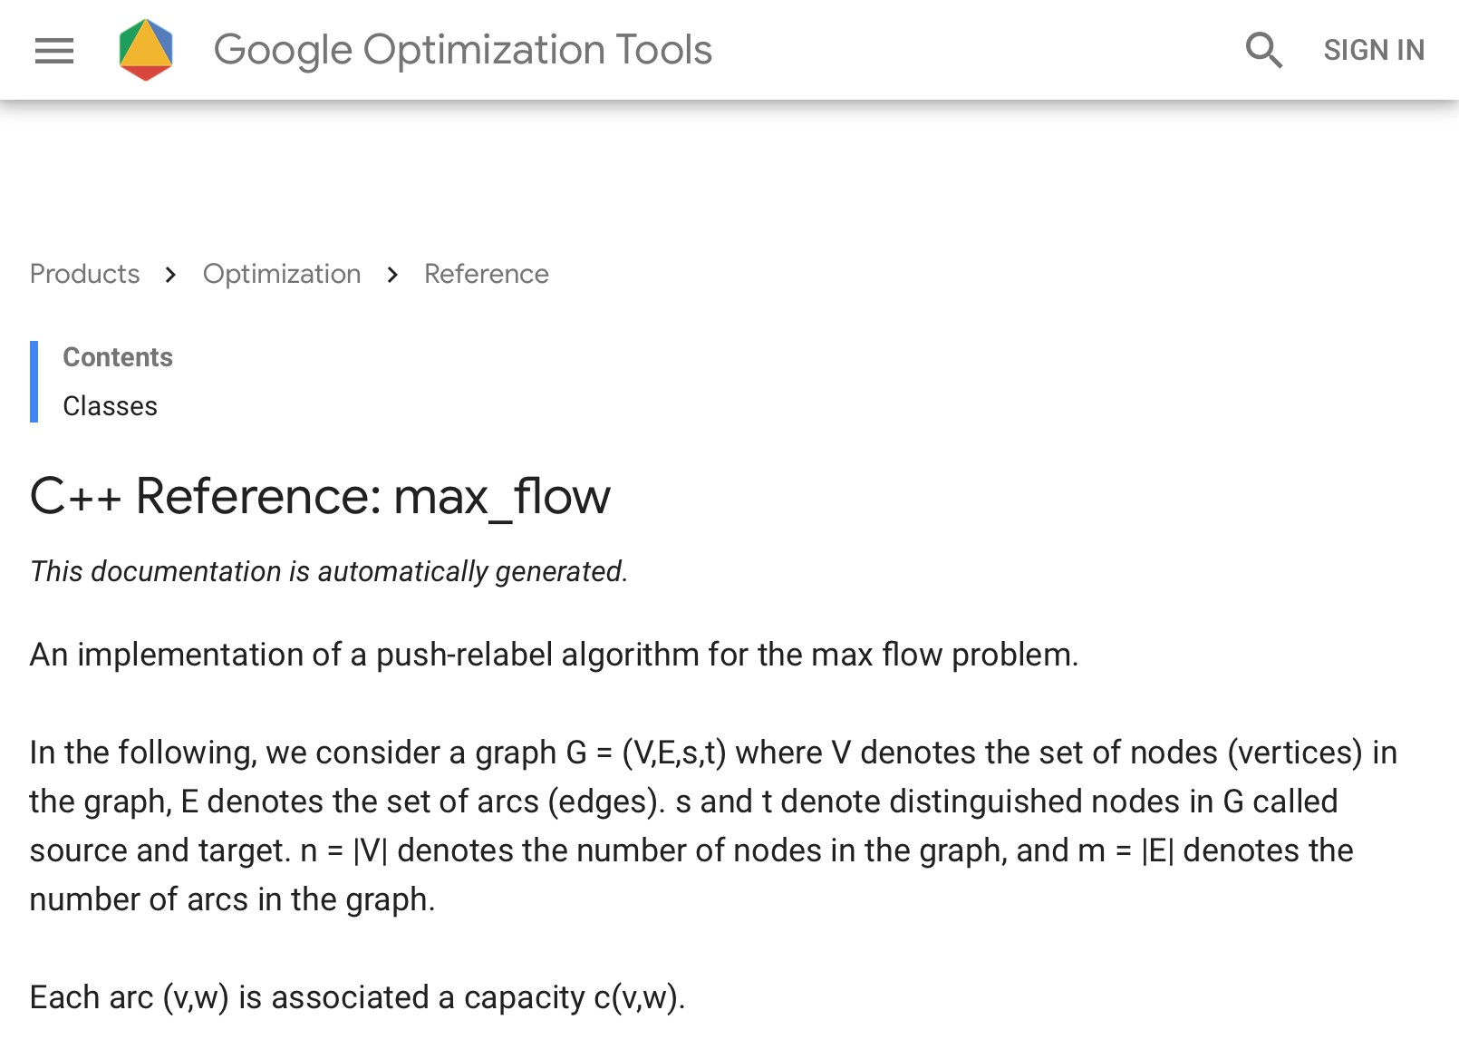



Maximum-flow algorithms: Google

Slide 83
7. Network Flow I
max-flow and min-cut problems
Ford–Fulkerson algorithm
max-flow min-cut theorem
capacity-scaling algorithm
shortest augmenting paths
Dinitz’ algorithm
simple unit-capacity networks

Slide 84
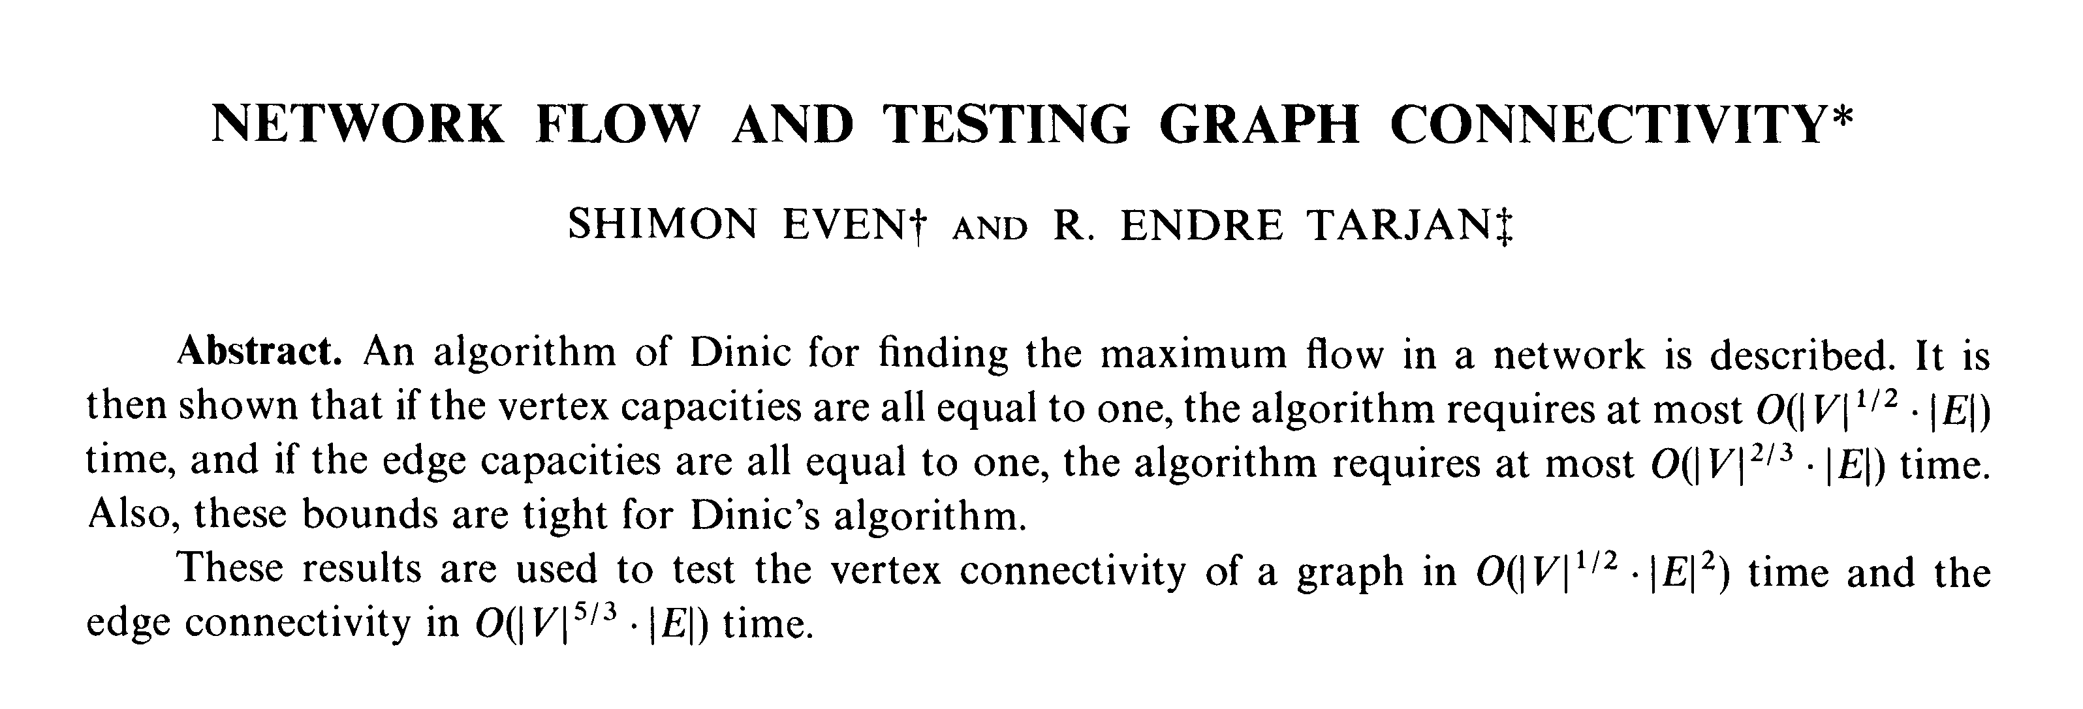
Network flow: quiz 7
Which max-flow algorithm to use for bipartite matching?
Ford–Fulkerson: O(m n C).
Capacity scaling: O(m² log C).
Shortest augmenting path: O(m² n).
Dinitz’ algorithm: O(m n²).
we’ll show that Dinitz’ algorithm runs in O(m n^{1/2}) time for bipartite matching
81

Slide 85
Simple unit-capacity networks
Def. A flow network is a simple unit-capacity network if:
・Every edge has capacity 1.
・Every node (other than s or t) has exactly one entering edge, or exactly one leaving edge, or both.
node capacity = 1
Property. Let G be a simple unit-capacity network and let f be a 0–1 flow. Then, residual network G_{f} is also a simple unit-capacity network.
Ex. Bipartite matching.
1
1
1

Slide 86
Simple unit-capacity networks
Shortest-augmenting-path algorithm.
・Normal augmentation: length of shortest path does not change.
・Special augmentation: length of shortest path strictly increases.
Theorem. [Even–Tarjan 1975] In simple unit-capacity networks, Dinitz’ algorithm computes a maximum flow in O(m n^{1/2}) time.
Pf.
・Lemma 1. Each phase of normal augmentations takes O(m) time.
・Lemma 2. After n^{1/2} phases, val( f ) ≥ val( f *) – n^{1/2}.
・Lemma 3. After ≤ n^{1/2} additional augmentations, flow is optimal. ▪
Lemma 3. After ≤ n^{1/2} additional augmentations, flow is optimal. Pf. Each augmentation increases flow value by at least 1. ▪
Lemma 1 and Lemma 2. Ahead.

Slide 87
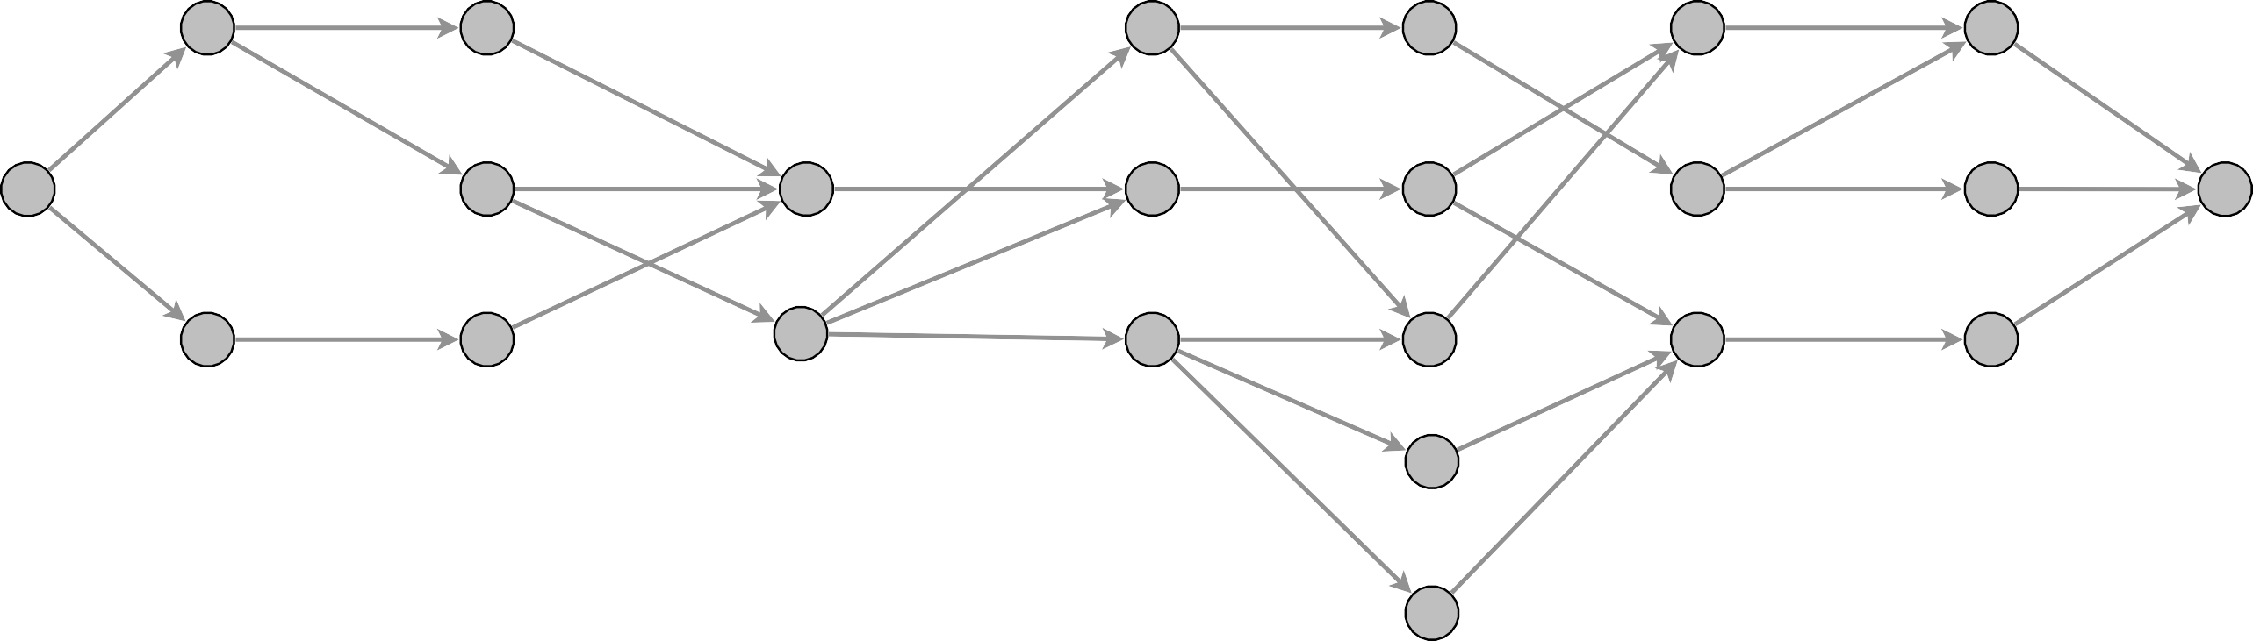
Simple unit-capacity networks
Phase of normal augmentations.
within a phase, length of shortest augmenting path does not change
・Construct level graph L_{G}.
・Start at s, advance along an edge in LG until reach t or get stuck.
・If reach t, augment flow; update L_{G}; and restart from s.
・If get stuck, delete node from L_{G} and go to previous node.
construct level graph
s
t
level graph LG

Slide 88
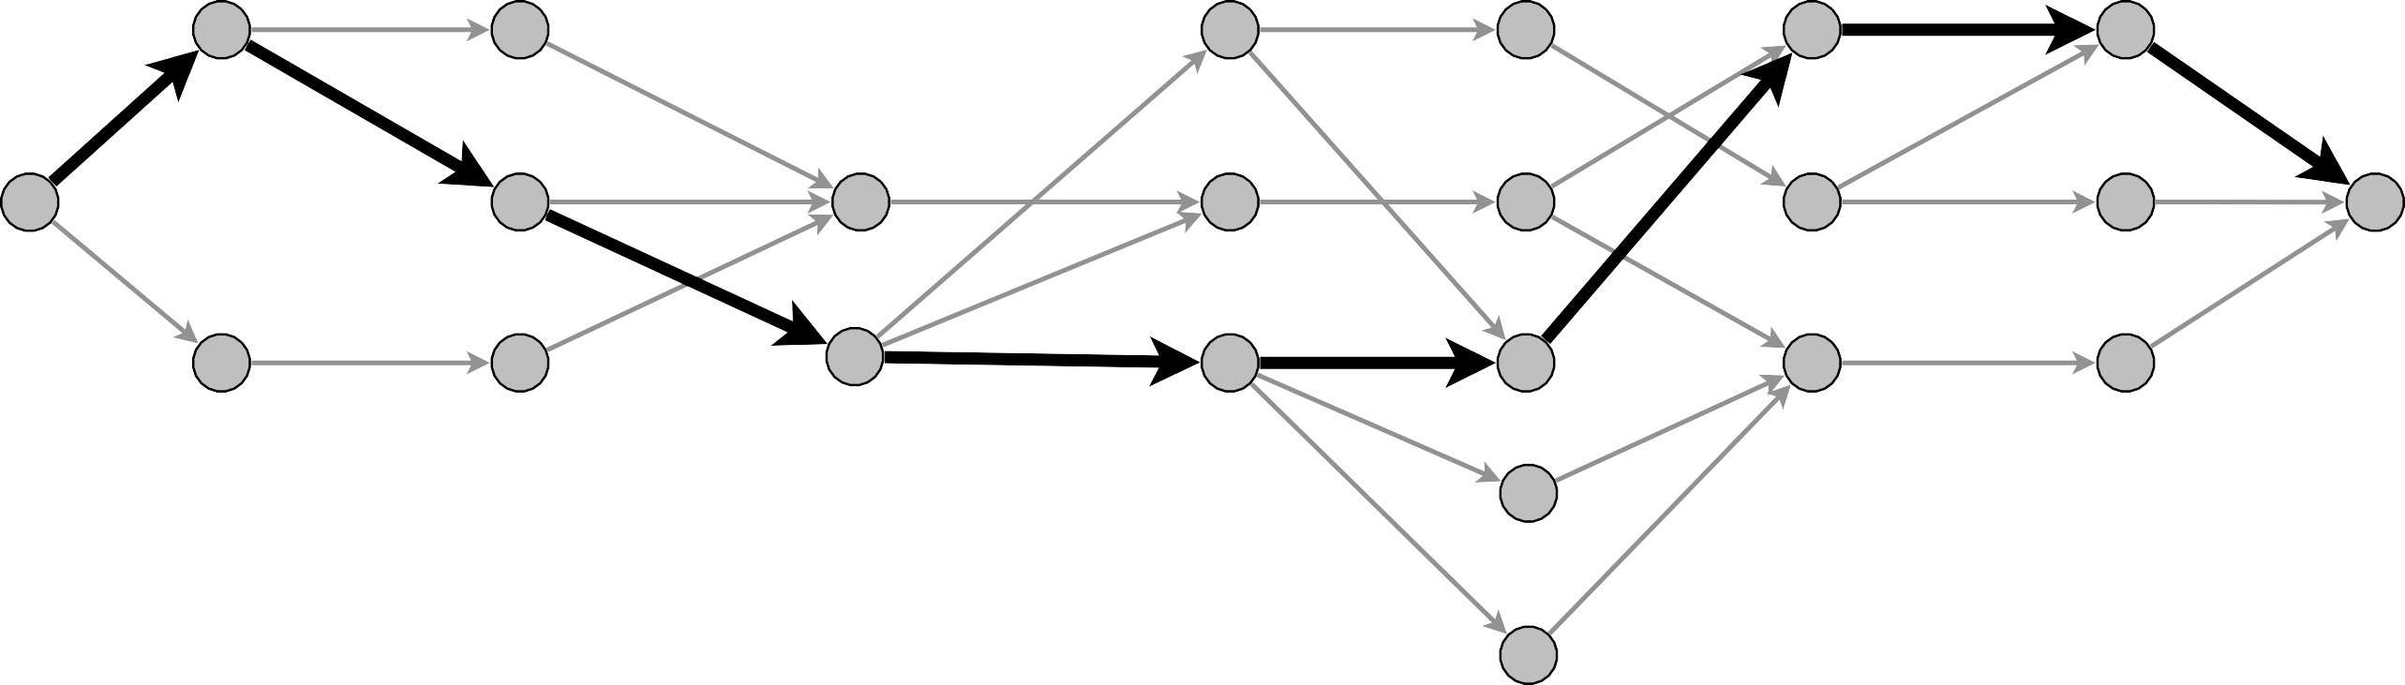
Simple unit-capacity networks
Phase of normal augmentations.
・Construct level graph L_{G}.
・Start at s, advance along an edge in LG until reach t or get stuck.
・If reach t, augment flow; update L_{G}; and restart from s.
・If get stuck, delete node from L_{G} and go to previous node.
advance
s
t
level graph LG

Slide 89

Simple unit-capacity networks
Phase of normal augmentations.
・Construct level graph L_{G}.
・Start at s, advance along an edge in LG until reach t or get stuck.
・If reach t, augment flow; update L_{G}; and restart from s.
・If get stuck, delete node from L_{G} and go to previous node.
augment
remove from level graph all edges in augmenting path
s
t
level graph LG

Slide 90
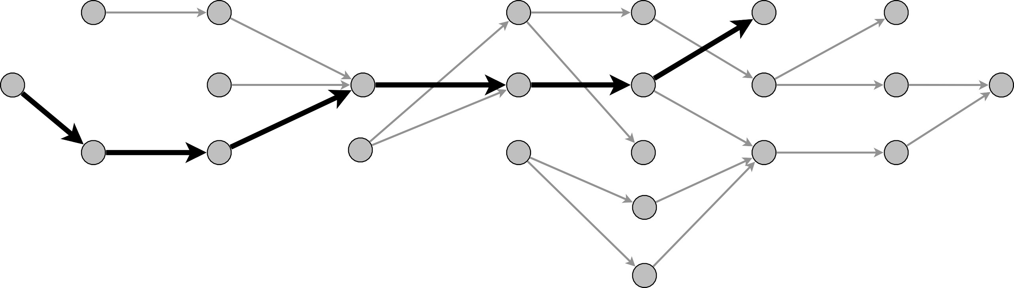
Simple unit-capacity networks
Phase of normal augmentations.
・Construct level graph L_{G}.
・Start at s, advance along an edge in LG until reach t or get stuck.
・If reach t, augment flow; update L_{G}; and restart from s.
・If get stuck, delete node from L_{G} and go to previous node.
advance
s
t
level graph LG

Slide 91

Simple unit-capacity networks
Phase of normal augmentations.
・Construct level graph L_{G}.
・Start at s, advance along an edge in LG until reach t or get stuck.
・If reach t, augment flow; update L_{G}; and restart from s.
・If get stuck, delete node from L_{G} and go to previous node.
retreat
s
t
level graph LG

Slide 92
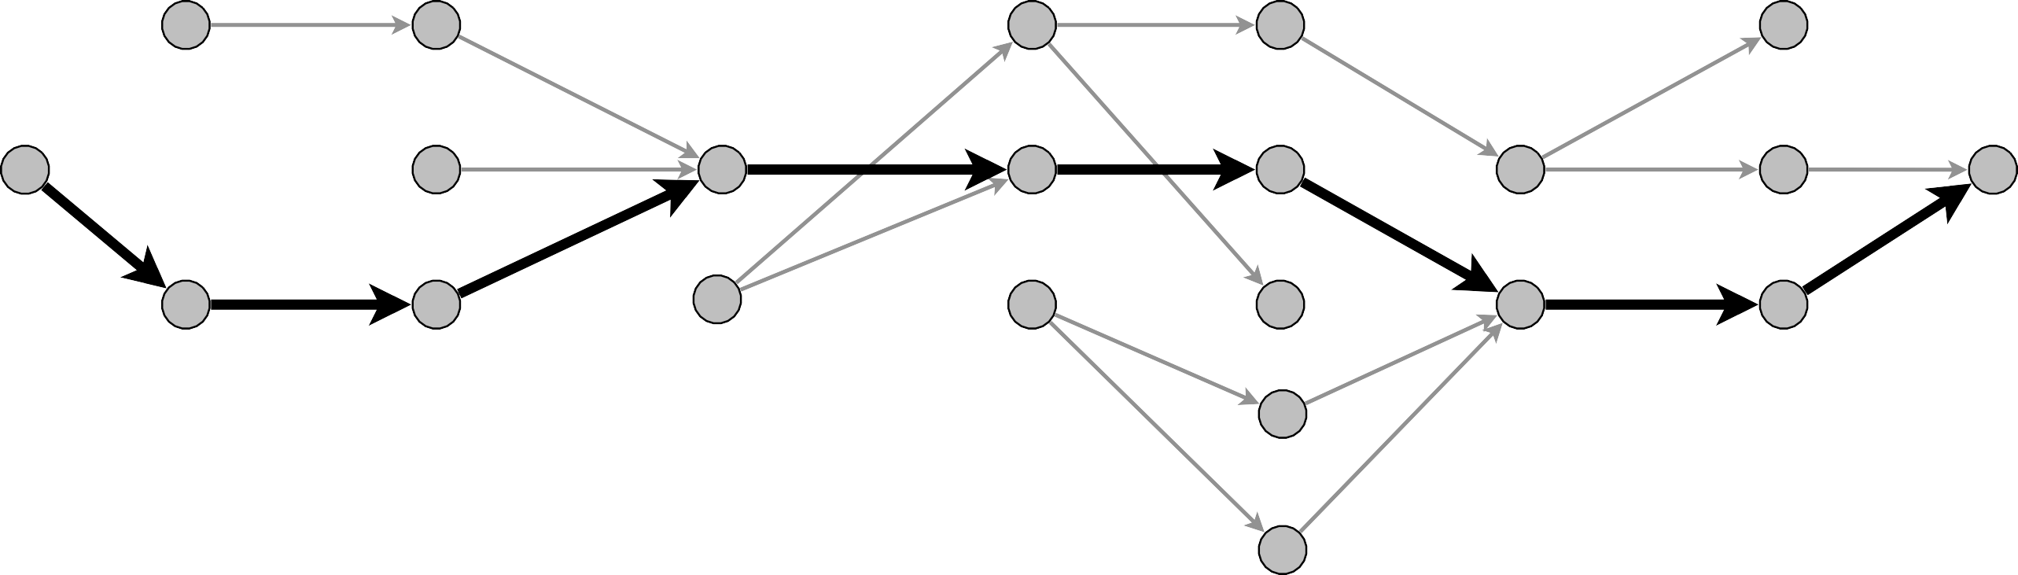
Simple unit-capacity networks
Phase of normal augmentations.
・Construct level graph L_{G}.
・Start at s, advance along an edge in LG until reach t or get stuck.
・If reach t, augment flow; update L_{G}; and restart from s.
・If get stuck, delete node from L_{G} and go to previous node.
advance
s
t
level graph LG

Slide 93

Simple unit-capacity networks
Phase of normal augmentations.
・Construct level graph L_{G}.
・Start at s, advance along an edge in LG until reach t or get stuck.
・If reach t, augment flow; update L_{G}; and restart from s.
・If get stuck, delete node from L_{G} and go to previous node.
augment
s
t
level graph LG

Slide 94
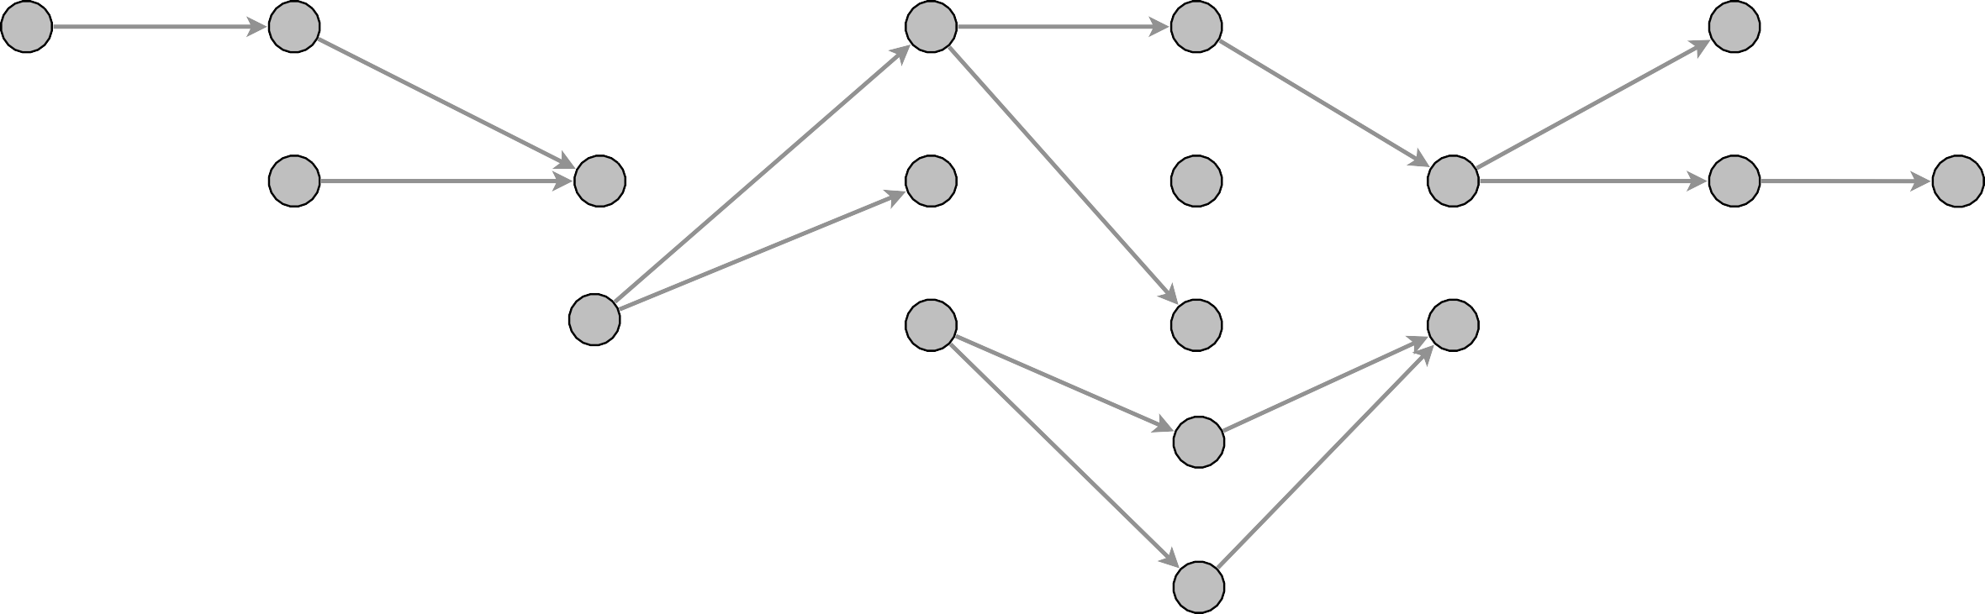
Simple unit-capacity networks
Phase of normal augmentations.
・Construct level graph L_{G}.
・Start at s, advance along an edge in LG until reach t or get stuck.
・If reach t, augment flow; update L_{G}; and restart from s.
・If get stuck, delete node from L_{G} and go to previous node.
end of phase (length of shortest augmenting path has increased)
s
t
level graph LG

Slide 95
Simple unit-capacity networks: analysis
Phase of normal augmentations.
・Construct level graph L_{G}.
・Start at s, advance along an edge in LG until reach t or get stuck.
・If reach t, augment flow; update L_{G}; and restart from s.
・If get stuck, delete node from L_{G} and go to previous node.
Lemma 1. A phase of normal augmentations takes O(m) time. Pf.
・O(m) to create level graph L_{G}.
・O(1) per edge (each edge involved in at most one advance, retreat, and augmentation).
・O(1) per node (each node deleted at most once). ▪

Slide 96
Network flow: quiz 8
Consider running advance–retreat algorithm in a unit-capacity network (but not necessarily a simple one). What is running time?
both indegree and outdegree of a node can be larger than 1
O(m).
O(m^{3/2}).
O(m n).
May not terminate.
useful for this
week’s homework!
93

Slide 97
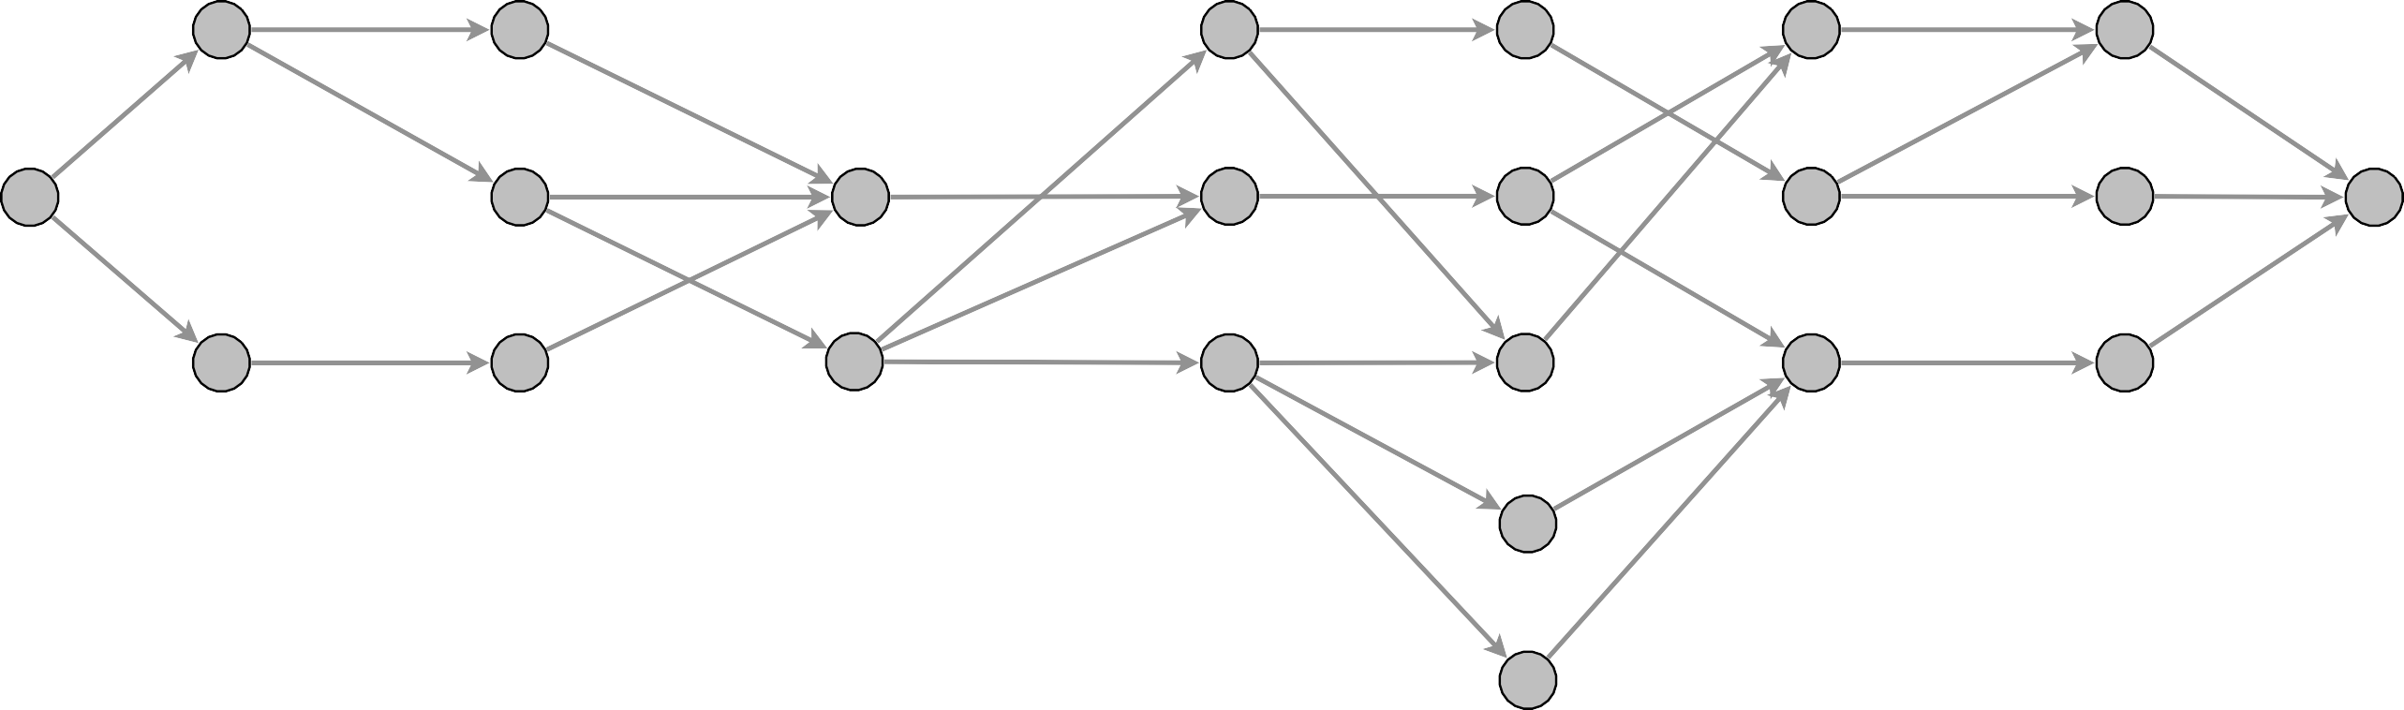
Simple unit-capacity networks: analysis
Lemma 2. After n^{1/2} phases, val( f ) ≥ val( f *) – n^{1/2}.
・After n^{1/2} phases, length of shortest augmenting path is >
_{n}1/2.
・Thus, level graph has ≥ n^{1/2} levels (not including levels for s or t ).
・Let 1 ≤ h ≤ n^{1/2} be a level with min number of nodes ⇒ ⎮Vh ⎮ ≤ n^{1/2}.
level graph LG for flow f
s
t
V₁
V_{h}
V_{n}1/2

Slide 98
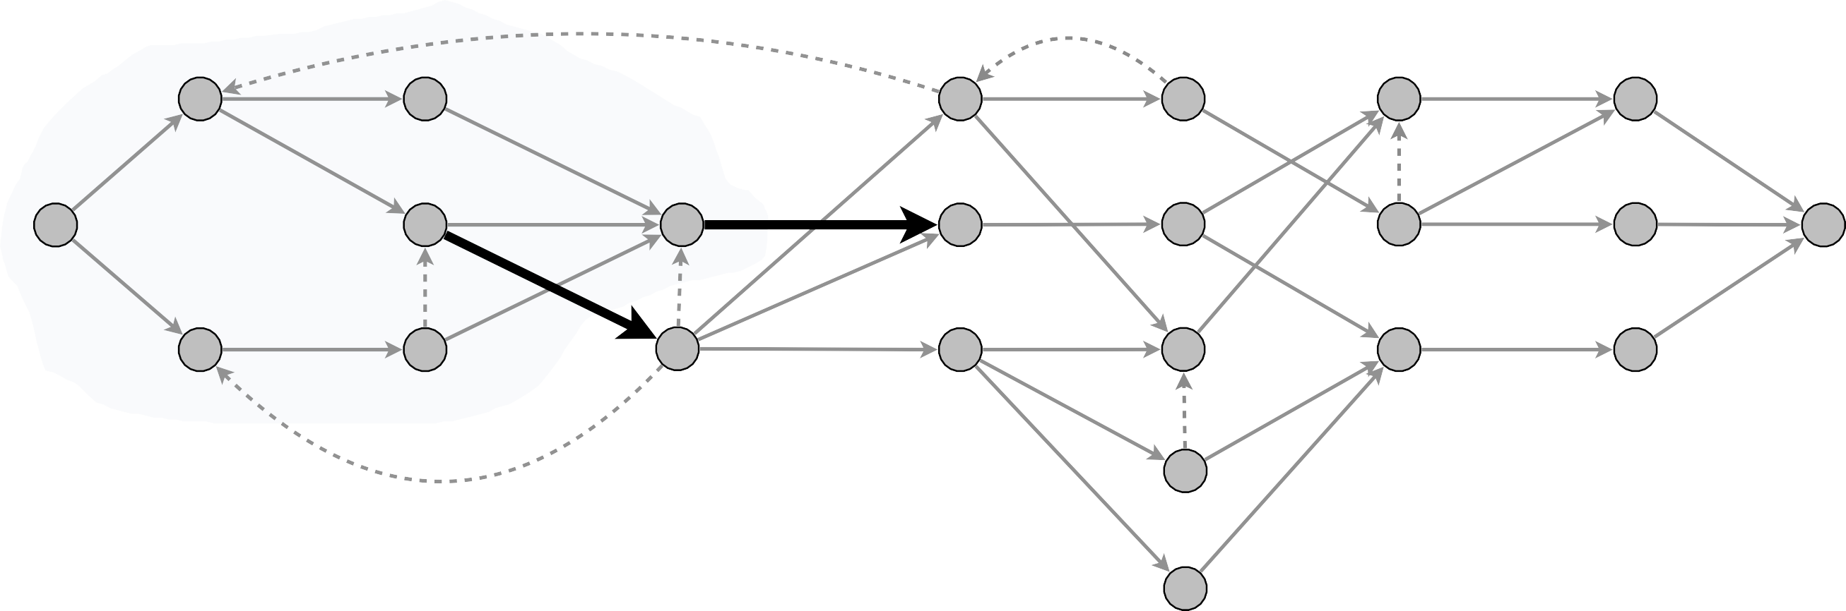
Simple unit-capacity networks: analysis
Lemma 2. After n^{1/2} phases, val( f ) ≥ val( f *) – n^{1/2}.
・After n^{1/2} phases, length of shortest augmenting path is >
_{n}1/2.
・Thus, level graph has ≥ n^{1/2} levels (not including levels for s or t ).
・Let 1 ≤ h ≤ n^{1/2} be a level with min number of nodes ⇒ ⎮Vh ⎮ ≤ n^{1/2}.
・Let A = {v : ℓ(v) < h} ∪ {v : ℓ(v) = h and v has ≤ 1 outgoing residual edge}.
・capf (A, B) ≤ ⎮Vh ⎮ ≤
_{n}1/2
⇒ val( f ) ≥ val( f *) – n^{1/2}. ▪
unit-capacity simple network
residual network Gf
residual edges
A
s
t
V₁
V_{h}
V_{n}1/2

Slide 99
Simple unit-capacity networks: review
Theorem. [Even–Tarjan 1975] In simple unit-capacity networks, Dinitz’ algorithm computes a maximum flow in O(m n^{1/2}) time.
Pf.
・Lemma 1. Each phase takes O(m) time.
・Lemma 2. After n^{1/2} phases, val( f ) ≥ val( f *) – n^{1/2}.
・Lemma 3. After ≤ n^{1/2} additional augmentations, flow is optimal. ▪
Corollary. Dinitz’ algorithm computes max-cardinality bipartite matching in O(m n^{1/2}) time.

